Slide 1
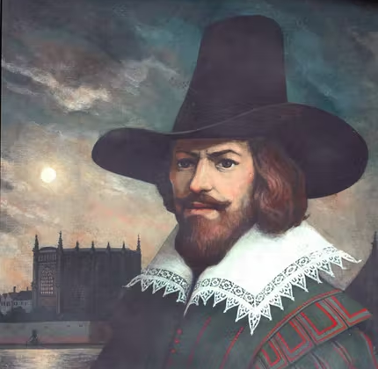
Guy Fawke’s Night
5th November

Slide 2
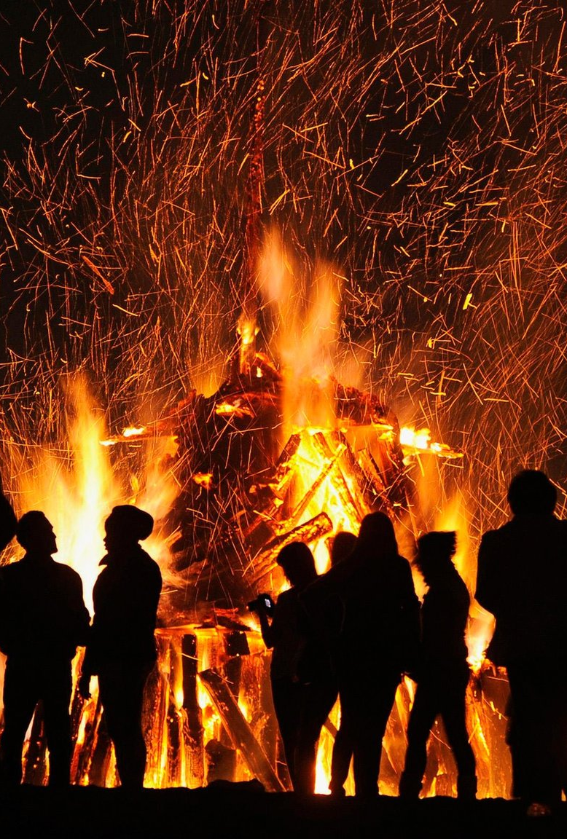
Remember, remember, the 5th of November,
Gunpowder, treason and plot.
I see no reason,
Why gunpowder treason,
Should ever be forgot.
Guy Fawkes, Guy Fawkes, 'twas his intent,
To blow up the King and the Parliament.

Slide 3
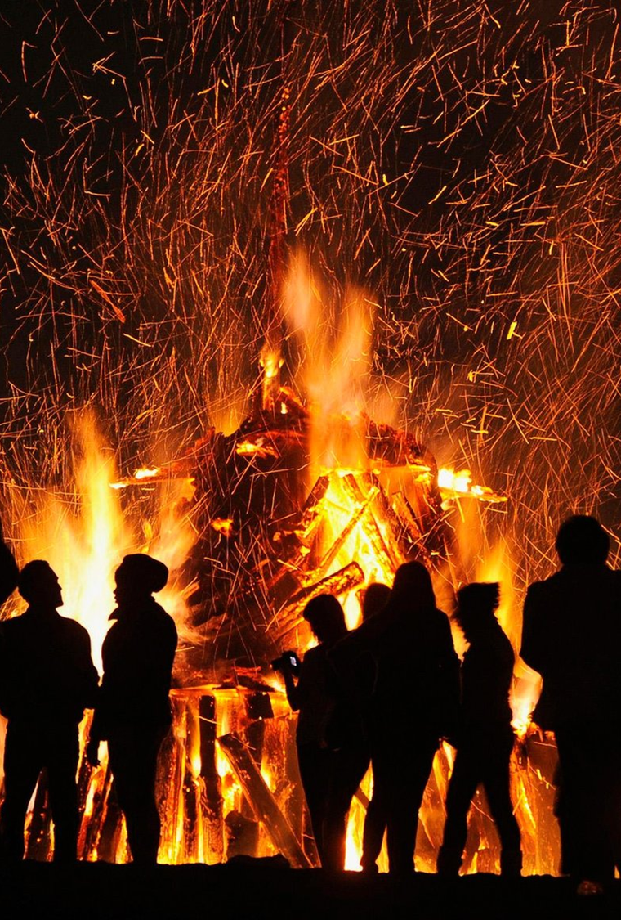
Three score barrels of powder below,
Poor old England to overthrow.
By God's providence he was catch’d,
With a dark lantern and burning match.
Holler boys, holler boys, let the bells ring,
Holler boys, holler boys,
God save the King!

Slide 4

Do you know why we celebrate Guy Fawke’s night?

Slide 5
Guy Fawkes Day celebrates the failure of a plot against the English government in 1605.
Several people, including a man named Guy Fawkes, planned to blow up the Houses of Parliament.
However, the government found out about the plot before the attack could take place.
The government arrested Guy Fawkes and his conspirators. This brought an end to what became known as the Gunpowder Plot.

Slide 6
Guy Fawkes and the others were convicted of treason.
The Parliament then announced a national day of thanksgiving to celebrate their survival.
The observance was set for the day the attack would have taken place, November 5.
The first celebration was held on November 5, 1606.

Slide 7

Which of our British values was Guy Fawkes trying to damage?

Slide 8
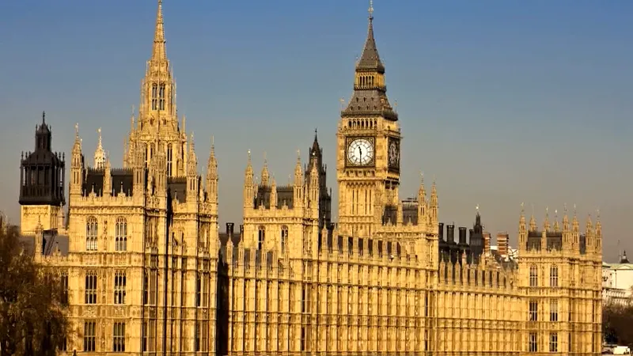
What do the Houses of Parliament represent?

Slide 9
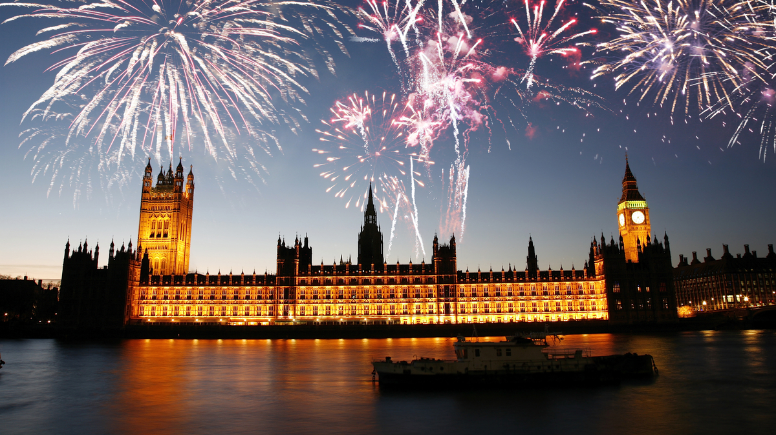
Remember, remember the 5th of November

