Slide 1
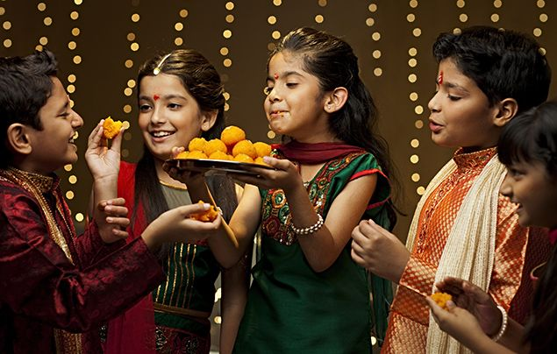
Diwali

Slide 2
Which Jewish celebration did we learn about last half term?
Why is it important to learn about many festivals and religions?
Which of our school values does this link to?
How will it help you to prepare for life in modern Britain?

Slide 3


Slide 4
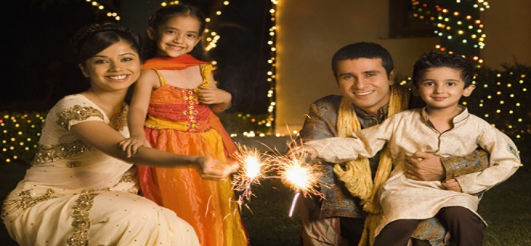
Hindus have been celebrating a special festival over the half term.

Slide 5
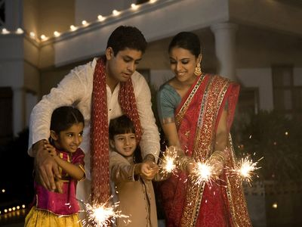
They have been celebrating Diwali.

Slide 6
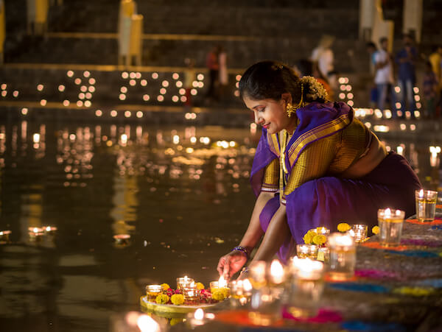
Diwali is also known as the festival of light.

Slide 7
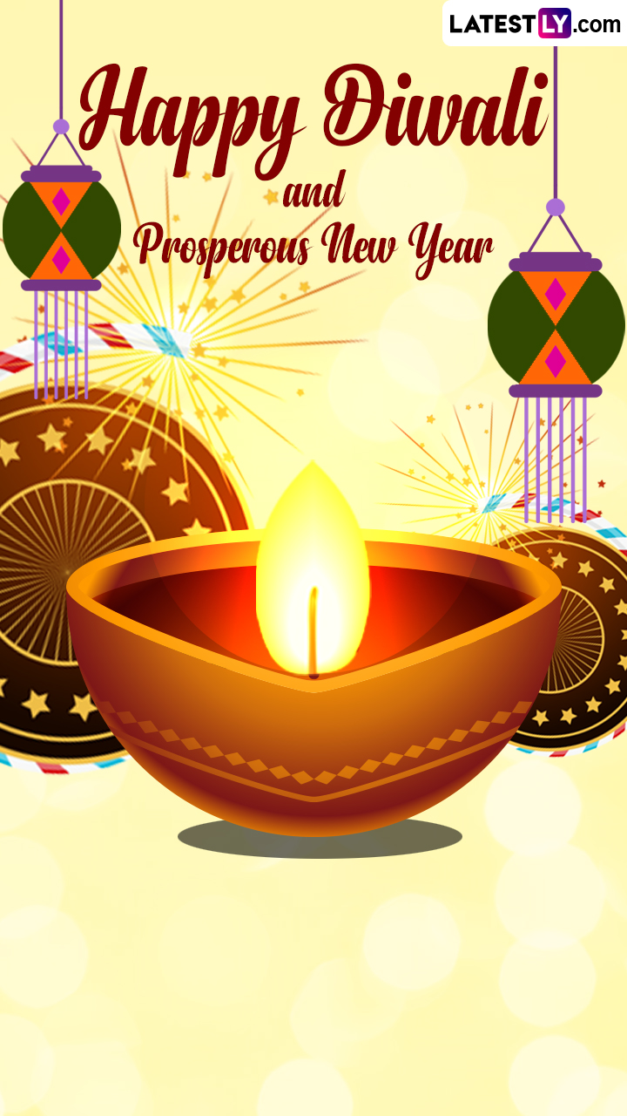
It lasts for 5 days and is the start of the Hindu new year.

Slide 8
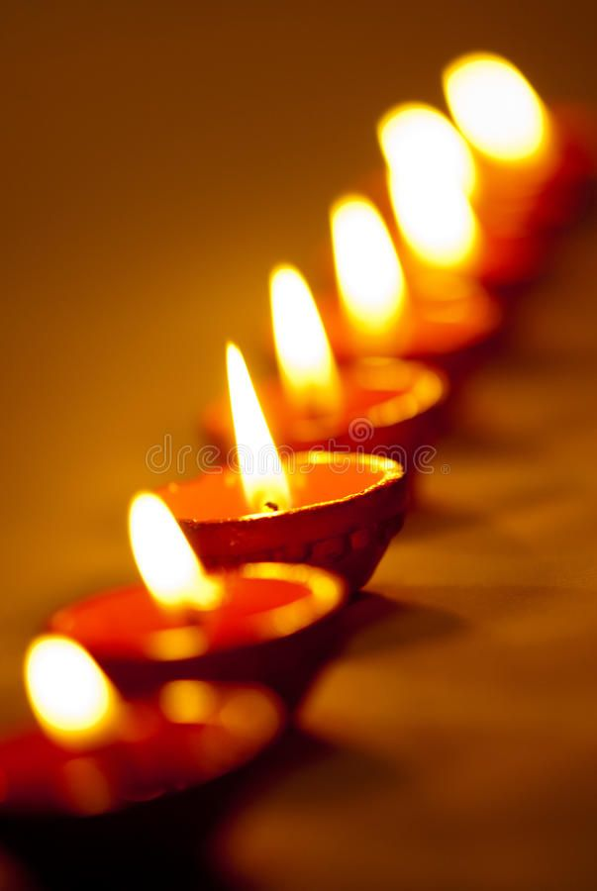
The word Diwali means row of lights.

Slide 9
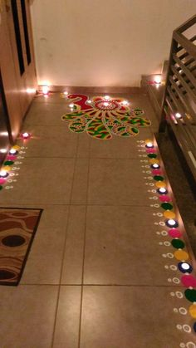
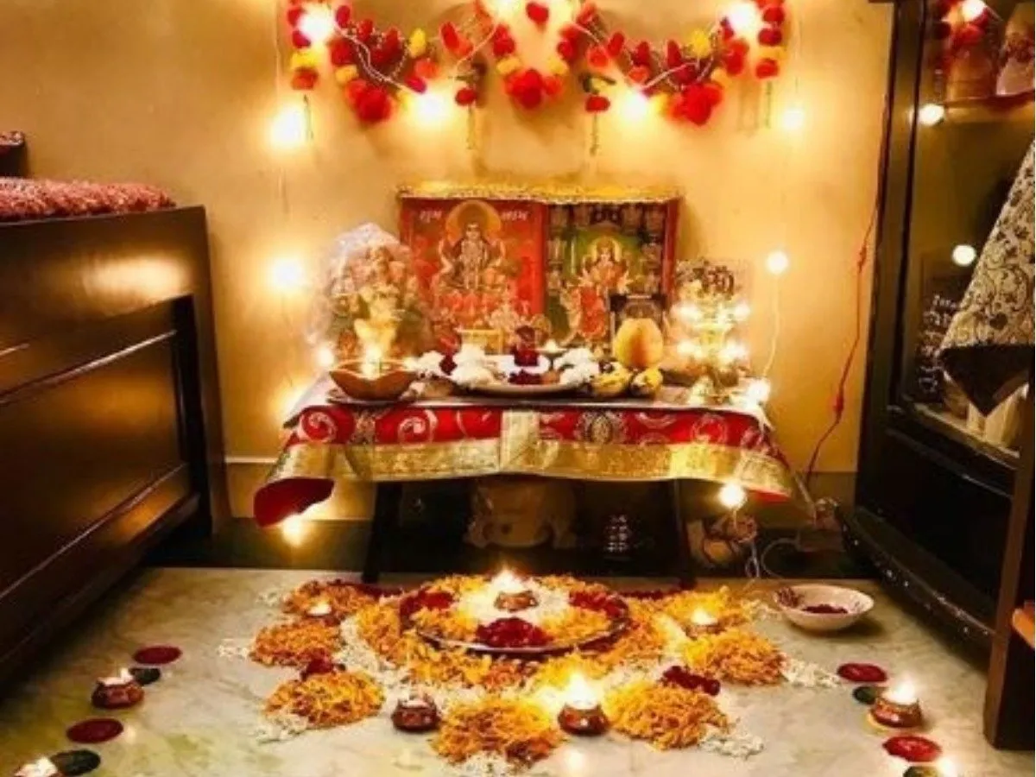
During Diwali, people decorate their homes with lights and oil lamps called divas.

Slide 10
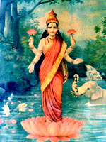
Diwali honours the Hindu Goddess Lakshmi and lights are lit to guide her into peoples’ homes to bring them prosperity for the new year.

Slide 11
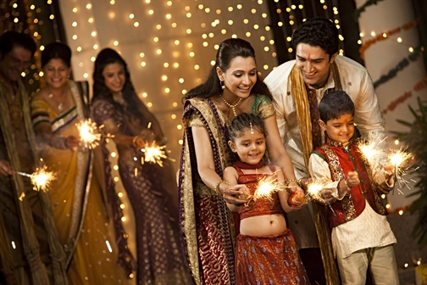
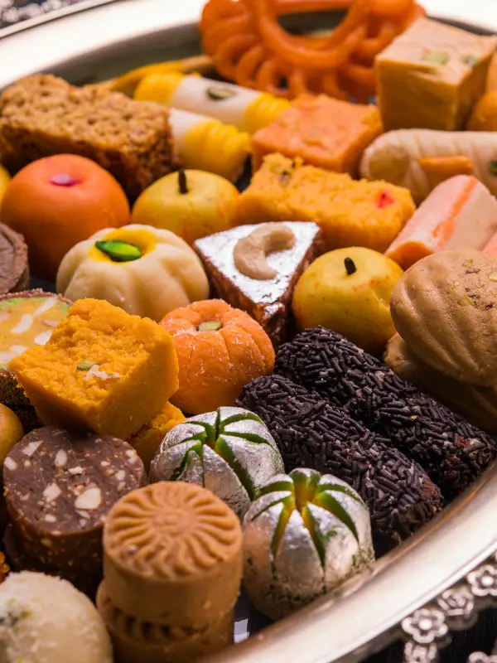
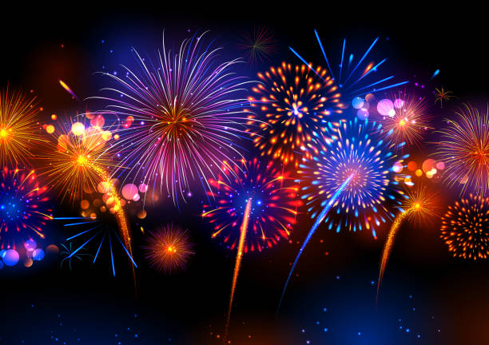
During Diwali, people spend time with friends and family, exchange gifts, eat sweet food and set off lots of fireworks. It is a time to come together.

Slide 12
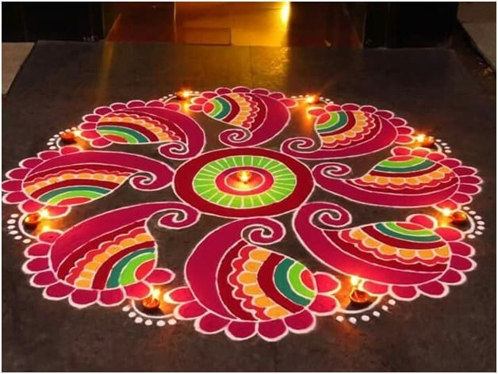
People celebrating Diwali, make rangoli patterns out of colourful powders and flowers to welcome the Gods and bring good luck.

Slide 13
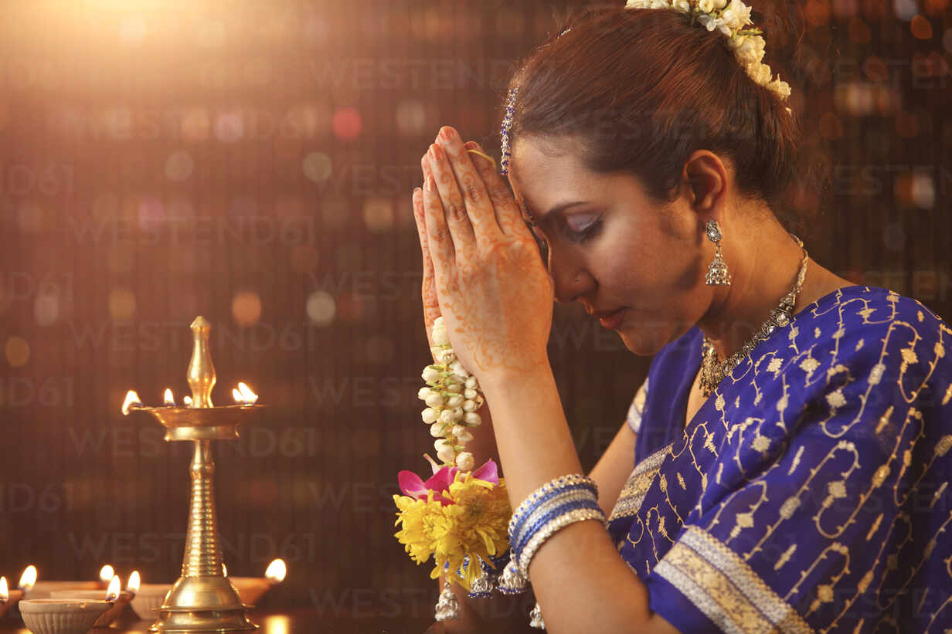
Diwali Prayer:
May the light dispel the darkness,
Enlighten your soul,
Illuminate your path and bless you in every way, every day.
Happy Diwali.

