Slide 1
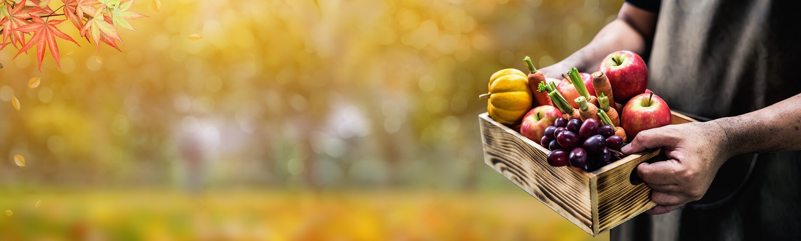
Harvest Festival

Slide 2
Harvest is a time to be thankful for all that we have and the hard work that farmers do to grow and harvest our food

Slide 3
It is also a time to think of others who may need some help

Slide 4
This year, your donations will be going to elderly residents that you have nominated or Springhill Court to help the residents who live there

Slide 5
Which of our values do you think we are upholding by helping others?

Slide 6
Moment of reflection:
Dear God, thank you for all that we have and for the farmers who provide it. Help us to think of others and help whenever we can, Amen

