Slide 1
What is racism?

Slide 2
Racism is when somebody Is treated differently because of their race, ethnicity, nationality or colour

Slide 3
Race is one of the protected characteristics so racism is illegal

Slide 4
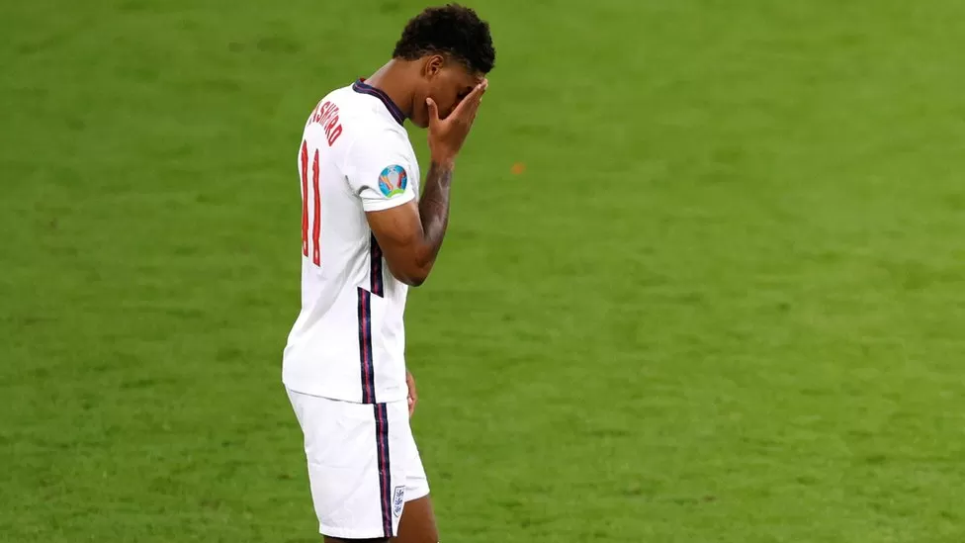

Marcus rashford and some other black footballers experienced racism after the final of the euro cup in 2020

Slide 5
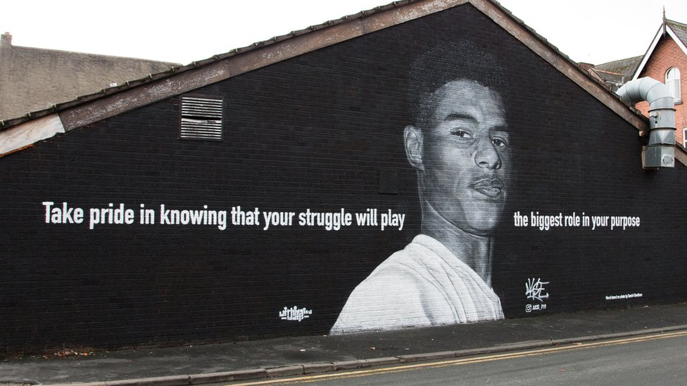
A mural of marcus was vandalised afterwards and lots of people visited it to show love and support for him and to stand up against racism

Slide 6
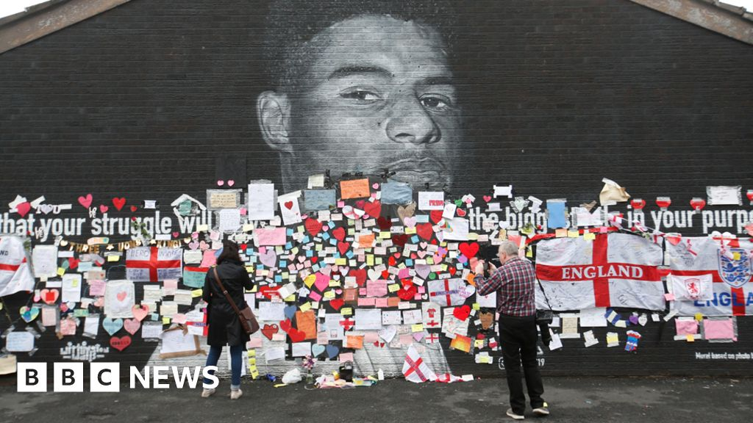

Slide 7
Racism is illegal and is classed as a hate crime

Slide 8
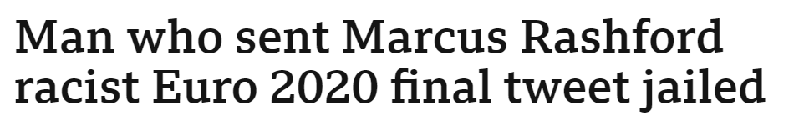
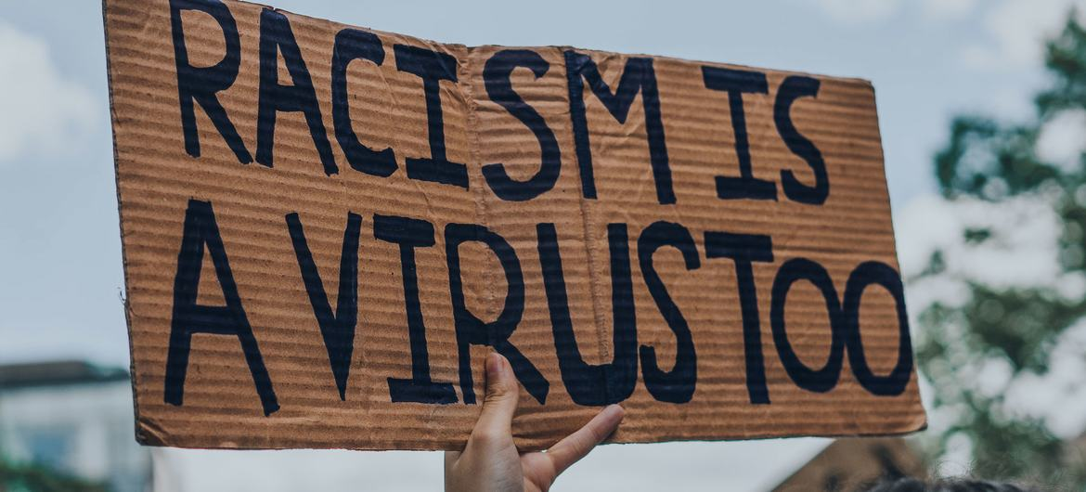
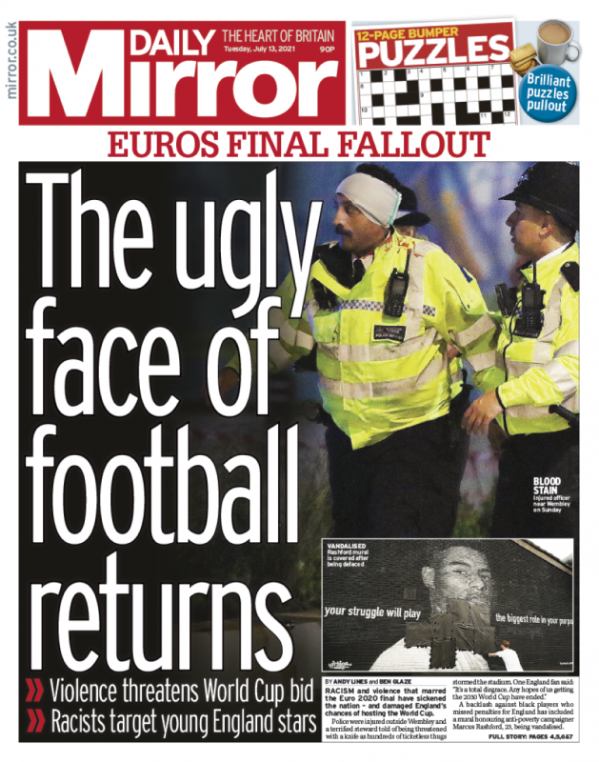
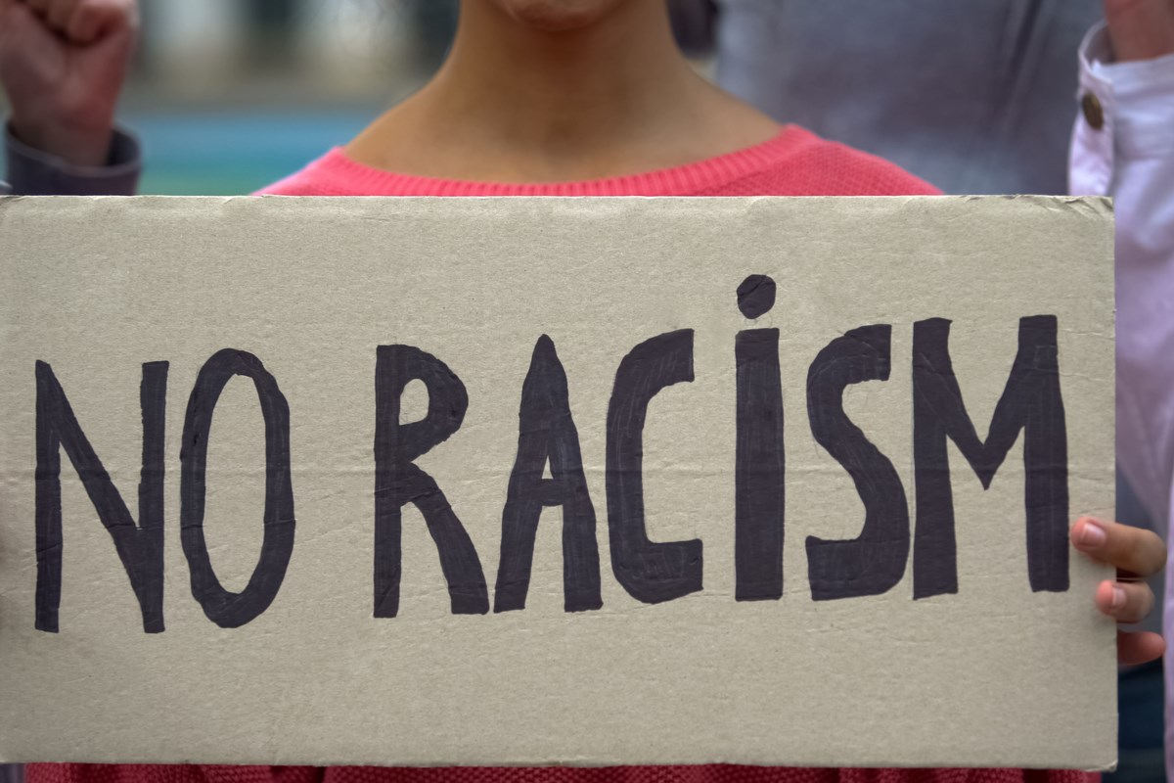

Slide 9
How does racism affect black people?
​

Slide 10
UNWELCOME
LONELY
ISOLATED
FEARFUL
UNSAFE
CONFUSED

Slide 11
HOW CAN WE TAKE RESPONSIBILITY TO MAKE SURE THERE IS NO RACISM IN OUR SCHOOL OR COMMUNITY AND EVERYBODY FEELS SAFE?
​

