Slide 1
Black history month

Slide 2
What is a role model?

Slide 3
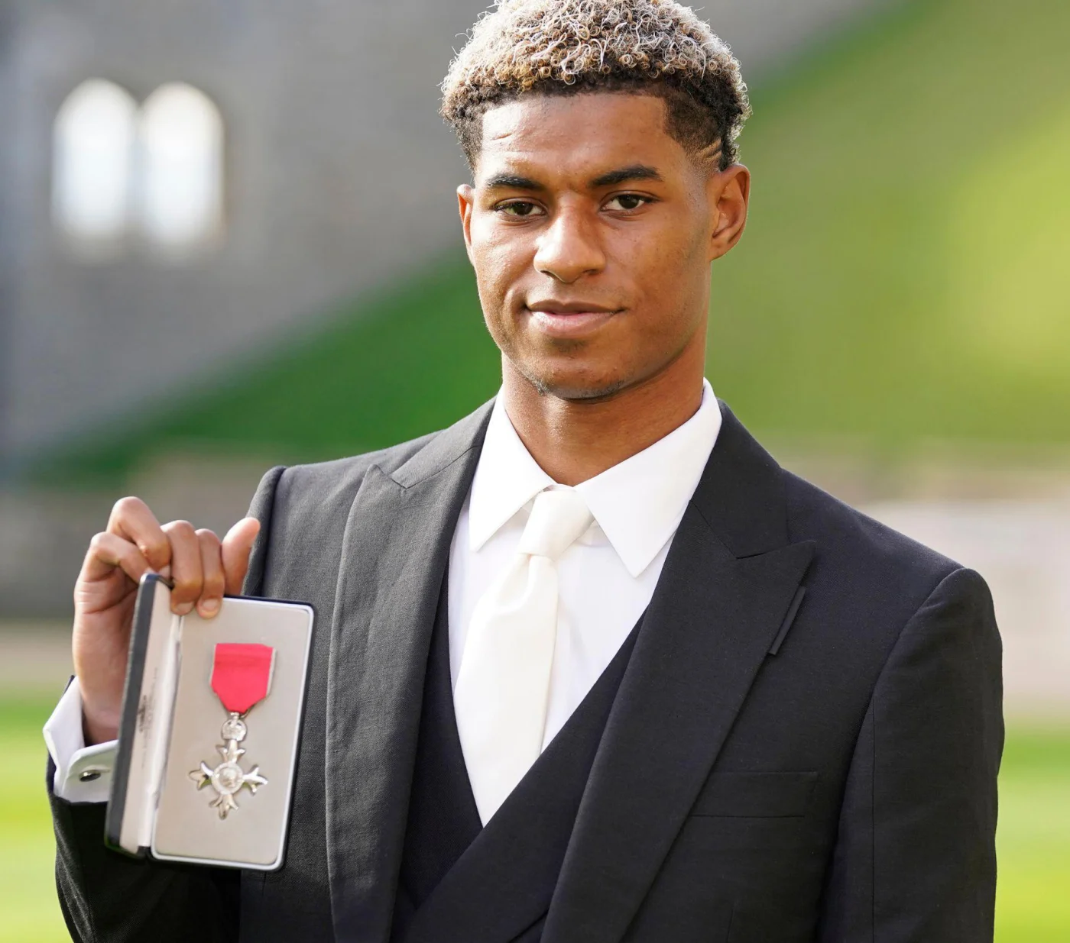
Why DO YOU THINK marcus rashford IS a role model?

Slide 4
Marcus’ early life:
MARCUS AND HIS 4 SIBLINGS WERE RAISED BY HIS MUM. HE DESCRIBES HER IN 3 WORDS:
STRONG, PROTECTIVE AND UNDEFEATED.

Slide 5
LIFE FOR THE FAMILY WAS HARD. His mum had 3 jobs but even that wasn’t enough. The family had to use foodbanks and soup kitchens and his mum went without food so that her children could eat.

Slide 6
During term time, marcus and his siblings had free school meals and breakfast and snacks at before and after school clubs.

Slide 7
Marcus worked hard to become a very successful footballer playing for Manchester utd and England.

Slide 8
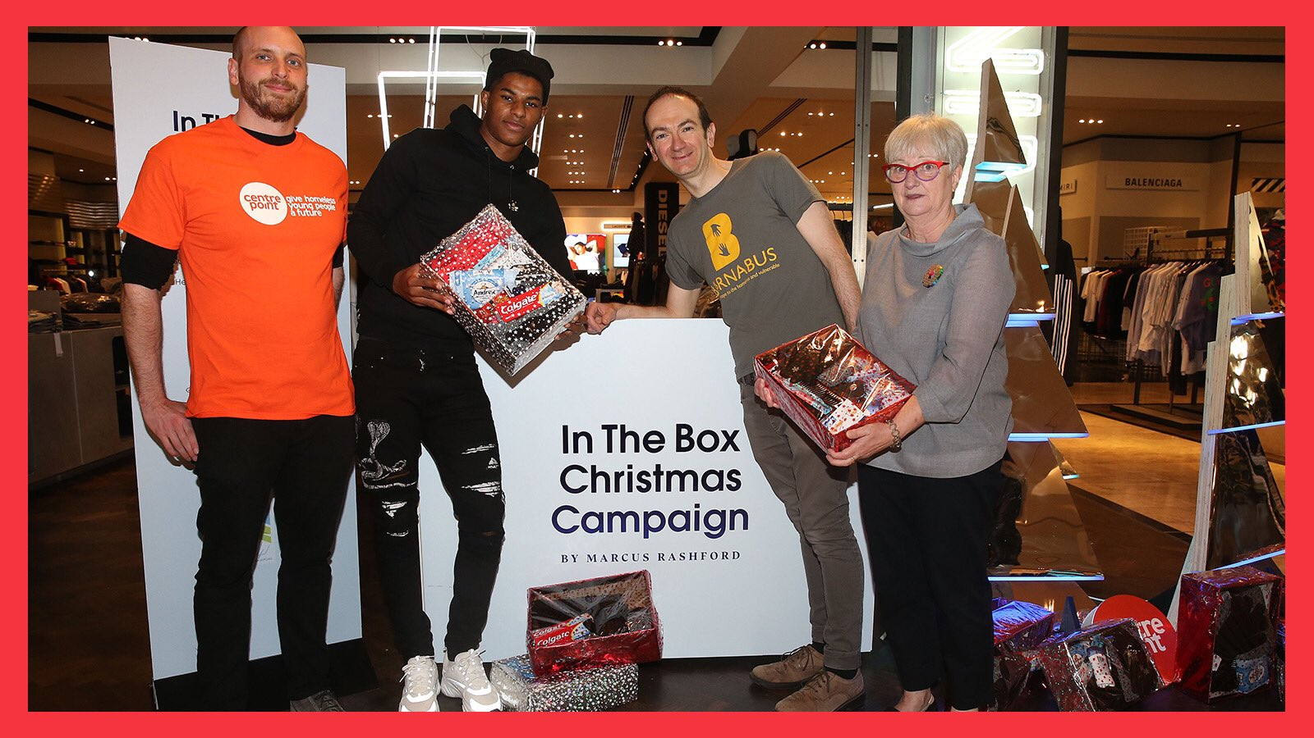
Marcus’ charity work
In 2019 he started a charity called ‘In the Box’ where people were asked to fill shoeboxes to deliver to homeless people.

Slide 9
Covid pandemic:
In 2020 when we went into lockdown some children no longer had access to free school meals and Marcus remembered how he and his family had relied upon them so much. Marcus started working for a charity called ‘Fair Share’ which raised £20 million and provided 4 million meals.

Slide 10
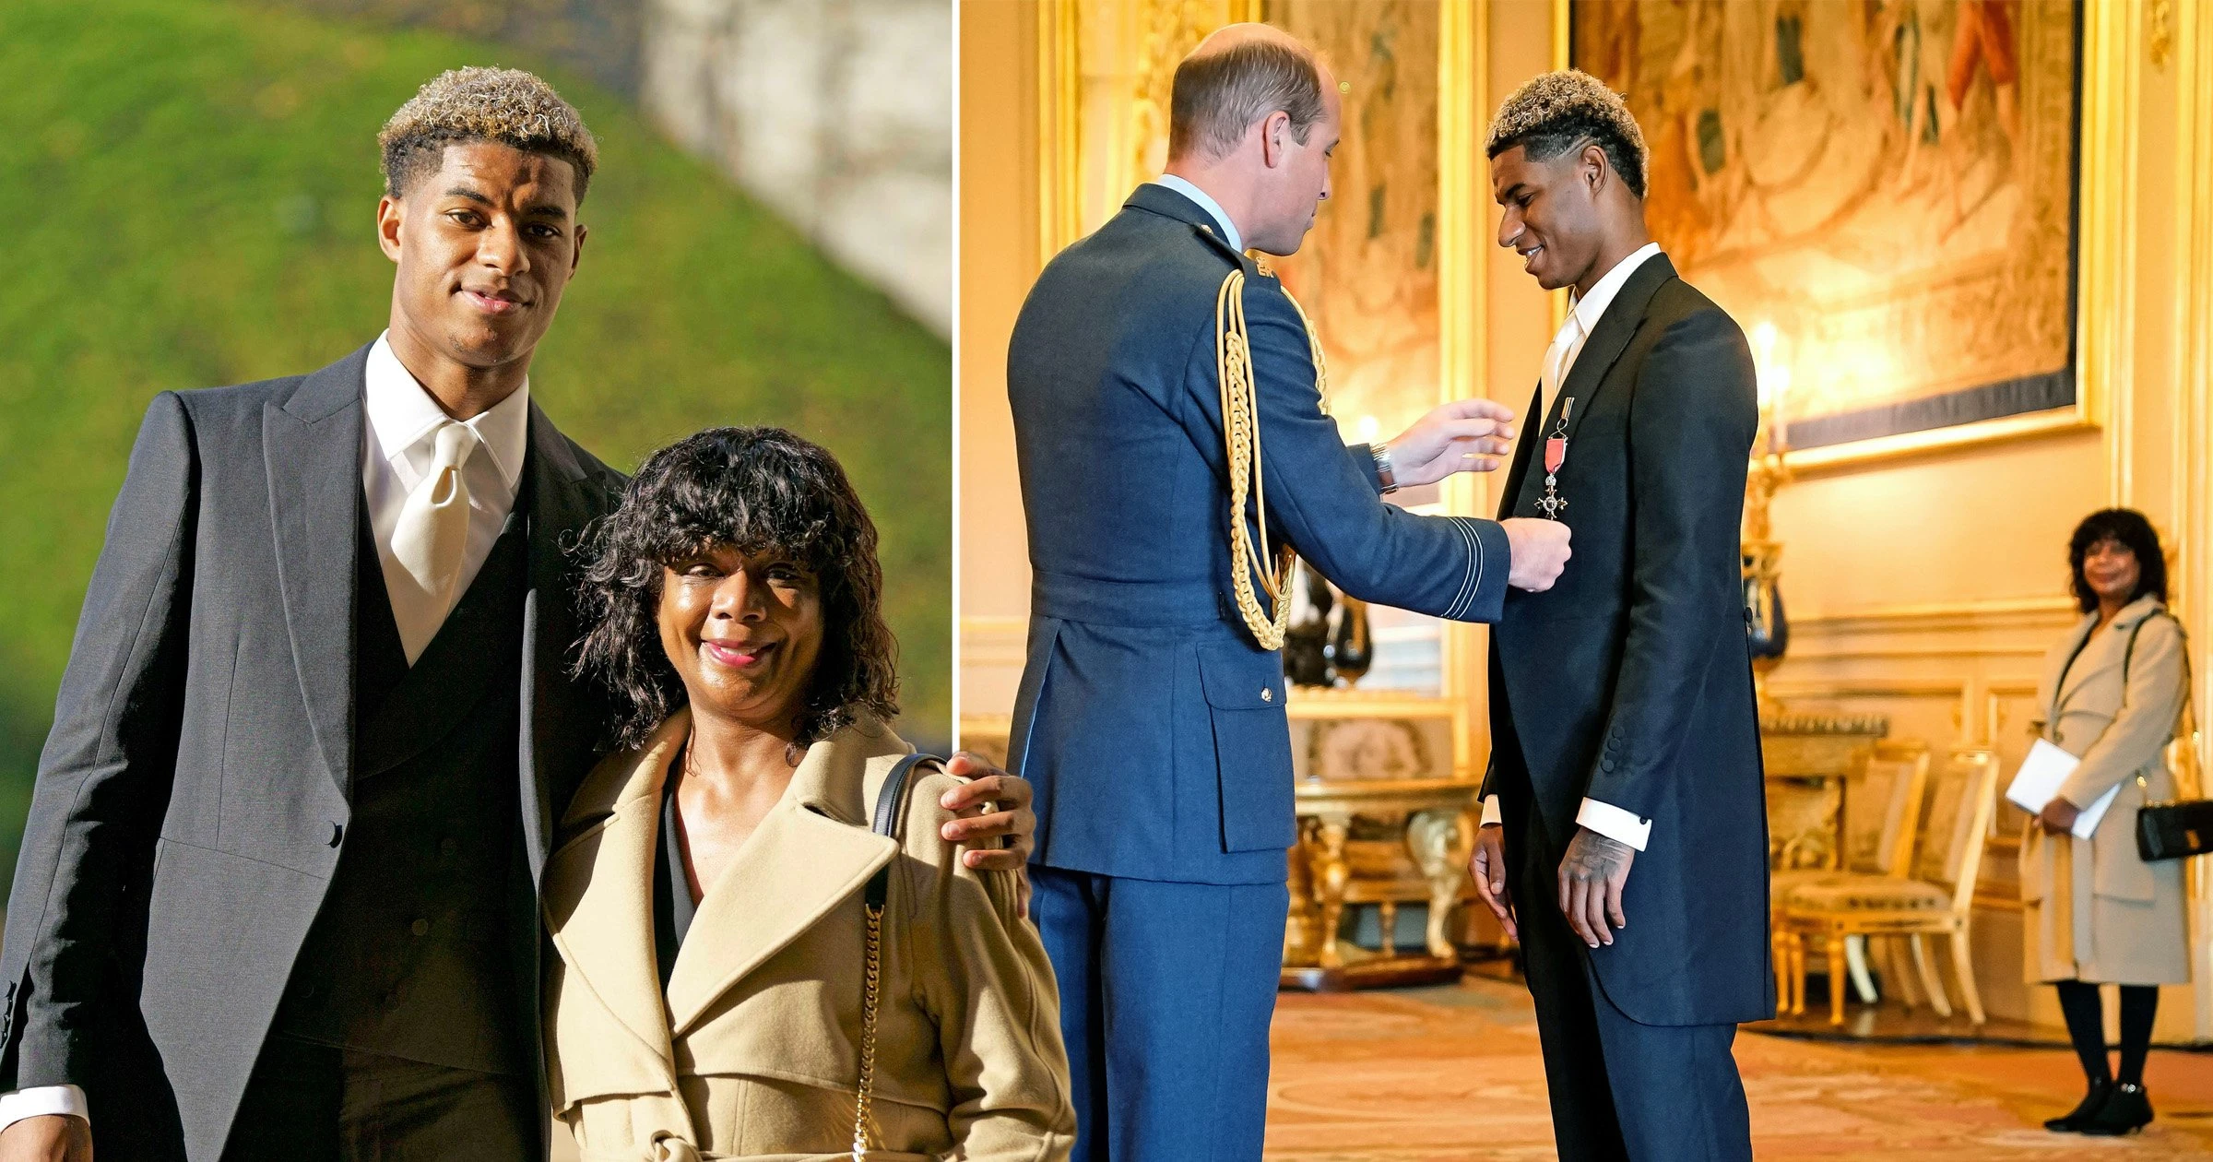
Covid pandemic:
When children went back to school in summer 2020, the vouchers they had been given for food stopped. Marcus wrote to every MP asking them to change this decision. The government agreed. In October 2022, Marcus was given an MBE for his work to support children.

Slide 11
Marcus then went on to start a petition to make sure children had enough food during the school holidays.
Which of our school values do you think Marcus has shown in his charity work.

