Slide 1

YOM KIPPUR
Sit Dolor Amet

Slide 2
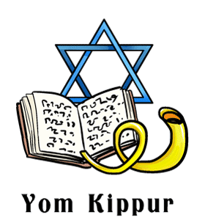
Vocabulary
Yom Kippur
Jewish
Judaism
Torah
Atonement / Atone
Fast
Sins

Slide 3
https://www.youtube.com/watch?v=kGrK2Zzvjew

Slide 4
Why do Jewish people celebrate Yom Kippur?

Slide 5
Which religion celebrate Yom Kippur?

Slide 6
What is Yom Kippur?

Slide 7
How do they celebrate?

Slide 8
Which of our values relates to Yom Kippur?

Slide 9
Responsibility
How can we take responsibility for our own actions?
How can we atone when we make a mistake?

