Slide 1

#]7,][]
[7=,-]
[
[7]
[7[7,]
7[,
[,’
‘’]]]

Slide 2
What is Black History Month?

Slide 3
Black History Month takes place every year in October across the world. The month presents an opportunity for children to learn more about Black history through lessons, assemblies and other activities across their community. It is also an opportunity for schools to emphasise their dedication to not tolerating racism in any way, shape or form.

Slide 4

Why do we have it?

Slide 5

Why is it important?

Slide 6
How does Black History Month link to our school values?

Slide 7
What do we already know about black history?

Slide 8
Which important people do we already know about in black history?

Slide 9
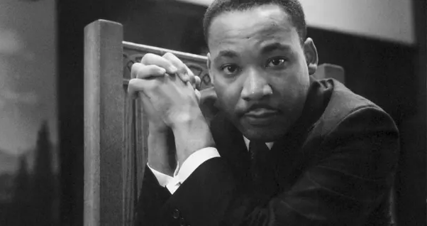
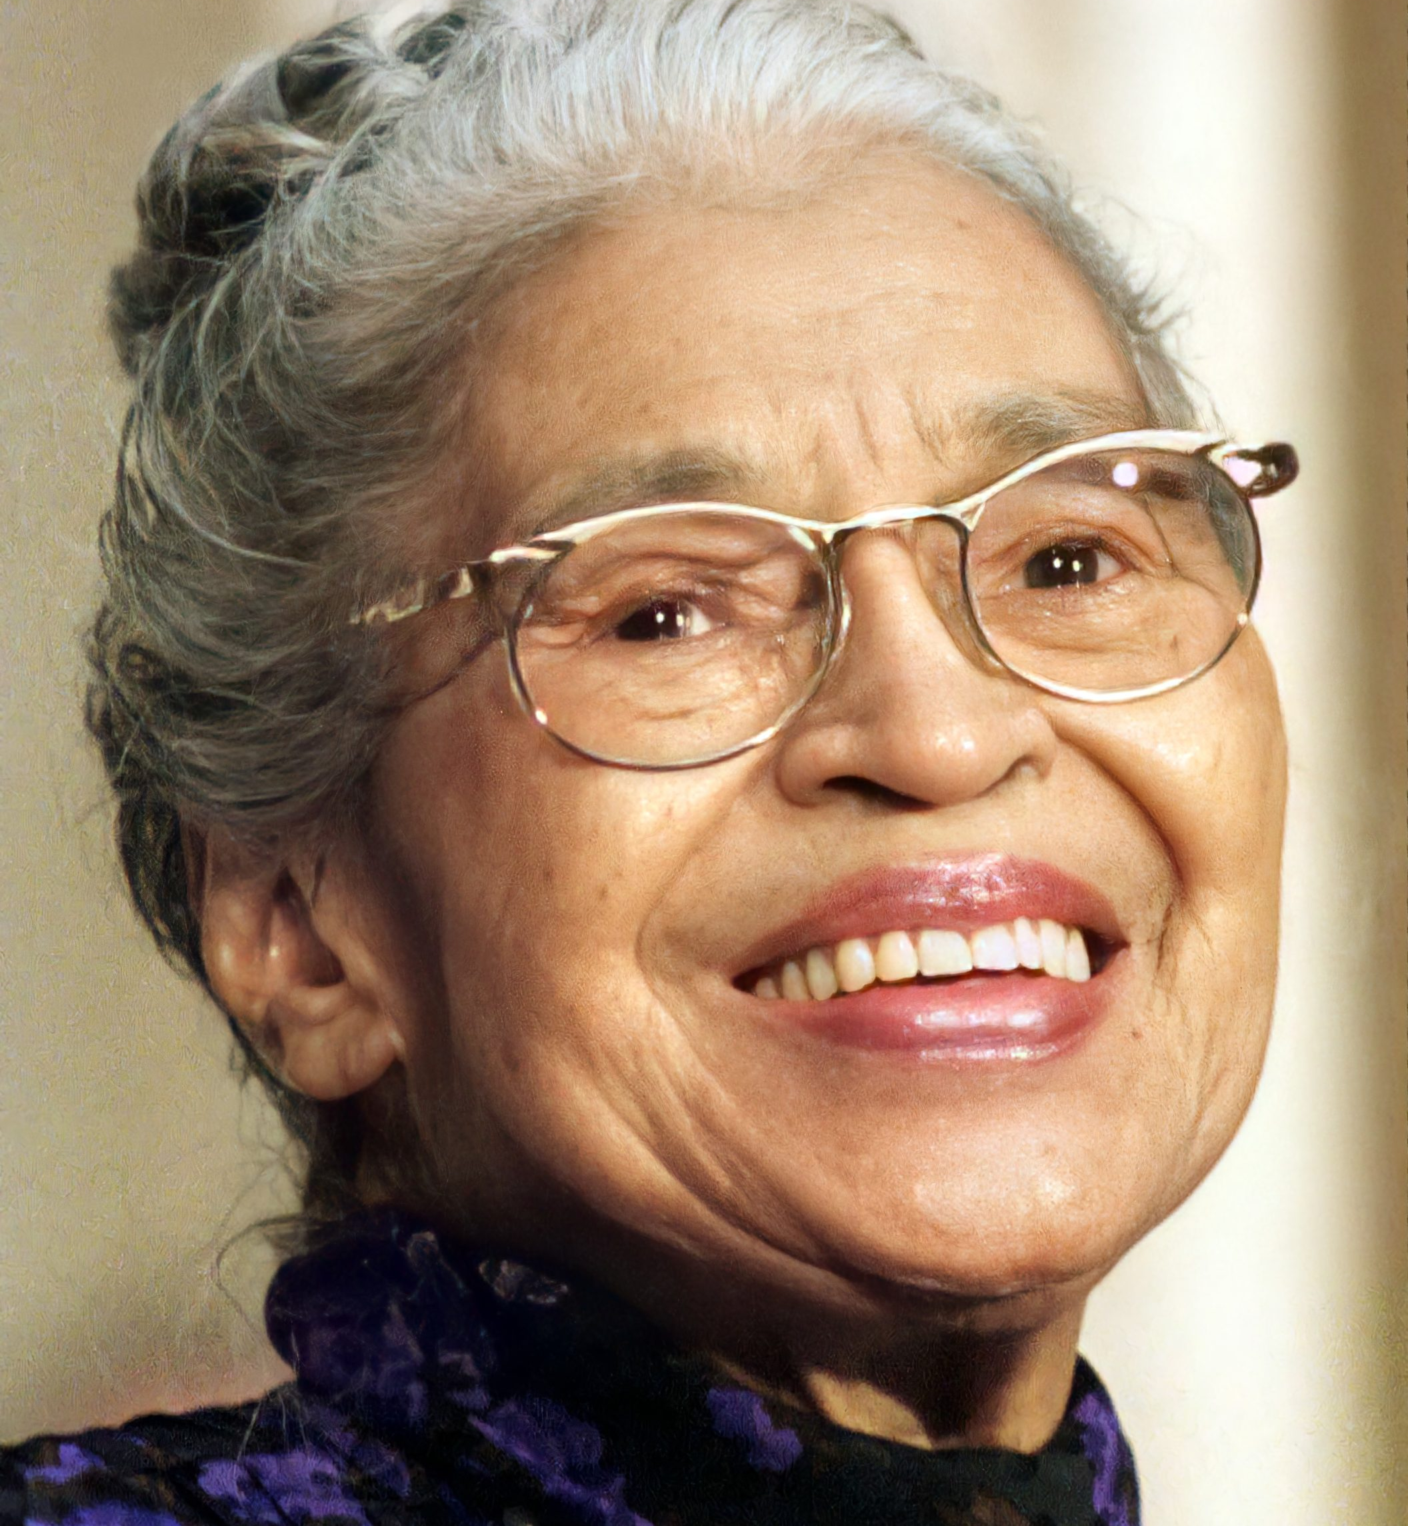
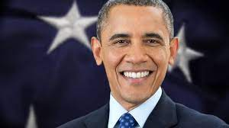
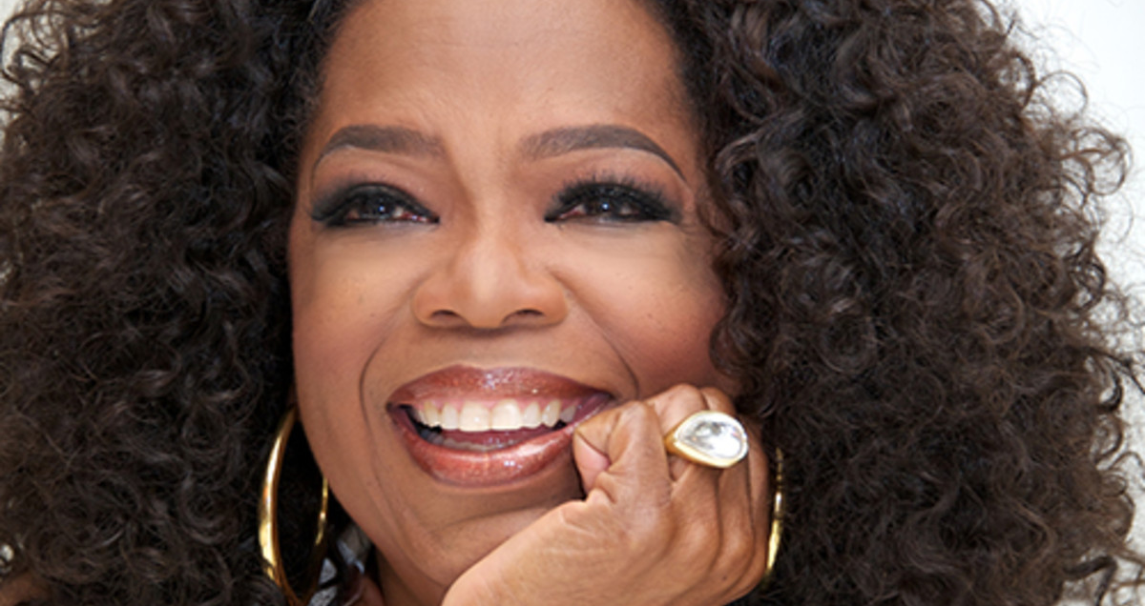
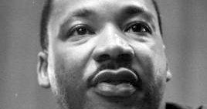
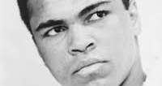

Slide 10
Do you know any black people who are important in British history?

Slide 11
Is there anybody you would like to learn about in our assemblies this month?

