Slide 1
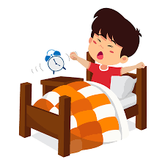
Morning Routines

Slide 2
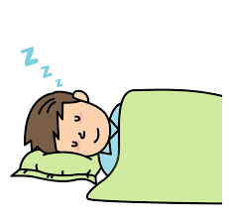
Bedtime Routine:
Firstly ensure you have followed your good bedtime routine so that your child has had enough sleep.
Remember, broadly, children need;
3-6 years: 10-12 hours sleep
7-12 years: 10-11 hours sleep
Morning routines will be easier the more sleep your child has had.

Slide 3
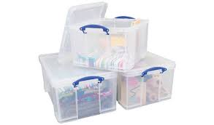
Evening Preparation:
To avoid the morning stress of searching for items when you need to leave the house, prepare everything the evening before.
School Clothes, out in a pile ready to put on.
School bag, packed with everything needed for the day – books, homework etc.
Shoes and coat by the door with the bag. If you have multiple children having specific pegs or plastic boxes with each child’s name means keeping everything in one place.
Packed lunch (if they have one) ready in the fridge.

Slide 4
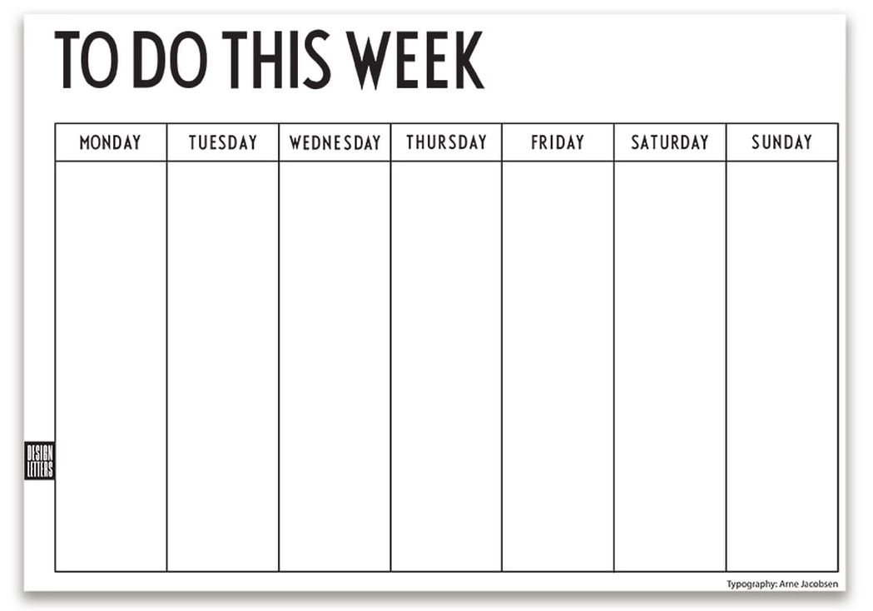
Weekly Planner
A lot of issues and stresses on a morning are when you suddenly remember it is a PE day or swimming, or they need a Secret Santa gift and you have to search or change and time is ticking.
Having a weekly planner will assist this. Use the school weekly newsletter to write the week’s activities, including PE days, homework and library days. Then use this on the evening packing your bag. Avoid those surprises!

Slide 5
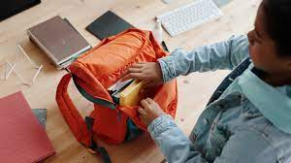
Children’s responsibility too
Make sure your child helps you do the evening prep, point out to them what the next day involves. Ask them to lay their clothes out but watch and check. Look on the weekly planner together, get them into the routine of knowing their homework must be back on a Wednesday etc. They are never too young to learn.
This will train them up to doing it themselves, especially in KS2 and certainly in preparation for secondary school.
This also assists them in knowing what is in their bag, so if a teacher says “have you got your reading folder?” Their answer isn’t I don’t know, they can confidently say “Yes I put it in last night,”

Slide 6
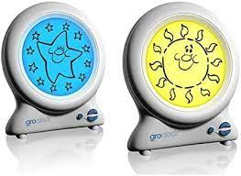
Getting up
Gro clocks can help if your child gets up at the wrong time.
It visually shows, when they can get out of bed. They cost
from £20.
An alarm clock is useful so they are used to hearing it is time to get up, rather than just relying on you.
When it is time to get up, open the curtains and put the light on. Don’t allow it to be too easy to fall back asleep. Give a couple of minutes warning that you will be pulling the covers back.
Introduce your morning routine timetable and show which action you are at.

Slide 7
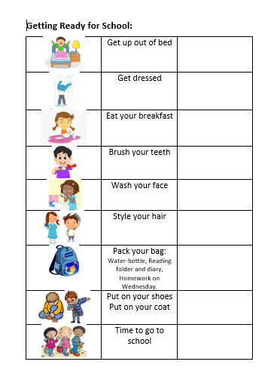
Morning Visual Timetable
            Like the bedtime routine some children like to follow a visual timetable to help manage their time and what is expected of them.
            Personally I think getting dressed first is helpful. It avoids them feeling cold, it is one action that can take time but if they are wanting breakfast can hurry them along.
            Your routine may be in a different order but it needs to be clear, as time is important on a morning and we don’t want anyone missing breakfast because they are late.
            If you would like a laminated copy please just ask and let me know the order you would prefer.

Slide 8
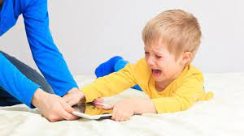
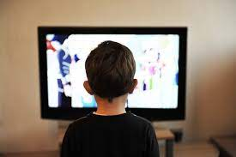
TV and distractions:
Avoid distractions such as putting the TV on or going on tablets in the morning.
Children cannot regulate the time they are on screentime and “just a minute” will end up being 10 minutes or an argument. If you feel it is manageable, perhaps they could have some time when EVERYTHING else is ready for going to school but only if you know your child will switch it off as soon as asked.

Slide 9
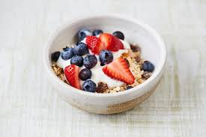
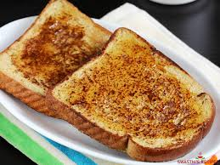
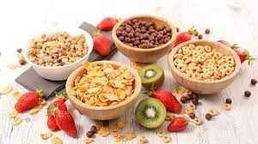
Breakfast
It is true that breakfast is the most important meal of the day.
Make sure your routine gives your child plenty of time to sit and eat, along with a drink.
Breakfast sets a child up for the day, improving their concentration and giving them the energy they need. Remember how long it has been since they last ate!
A young student’s brain uses up half of it’s body’s energy!
Please always tell school if breakfast has been missed, for any reason. We would rather find the time to give them something to eat, than them suffer with lack of concentration and be lethargic, irritable and hungry for the morning.
Just like all food it is ok to have sugary cereals- if it is in moderation. Remember to switch it up. Porridge is a great slow burner to feel full for longer. Toasts and fruit are great. A sugar high in the morning is followed by a sugar-low which will affect your child’s mood.

Slide 10
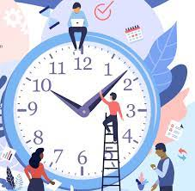
Timing
Whether it is getting to school or perhaps to a Before school Club your child needs to know you are leaving the house at a certain time.
Keep it the same, up at the same time, breakfast at the same time. That way it becomes the routine and harder to be late leaving the house.
Again using the Morning Timetable, moving the arrow or ticking off until it is embedded and just naturally one activity follows the other.
Do you yourself have a routine? What happens if you change it?

Slide 11

Reward:
It is a personal choice of how you reward your child for following their routine.
Each family and even each child is individual of how they react to praise and reward.
Reward doesn’t mean a present, it could be a huge cuddle and praise for doing so well. It could be extra TV/Computer time on a Friday evening. It could be a trip to the park. It could be that a sticker chart is good motivation. If you choose to buy a gift for their cooperation then that is your personal choice. The most important thing is that your child knows that you are proud of them following the routine and that is helping everyone be where they need to be on time, making everyone happy and less stressed!

Slide 12
Any Questions???
Again this has been an overview of making a morning routine.
Each family have their individual problems that I am happy to discuss, unpick and come up with a plan to try to help.
One step at a time to ease the stresses of a busy morning.

