Slide 1

Bedtime Routines

Slide 2

Bedtime Routines;
Creating a unique routine that fits your family and that you continuously follow, is key to getting it to work.
If your child knows they can change the routine to suit them or you are going to ‘give in’ for a quiet evening, it won’t help in the long run.
Write down and discuss the routine as a family so they know exactly what is expected – but make it fun and something to look forward to!
Write down the key problems – getting out of bed, scared of the dark, saying they are not tired etc. Then work your plan around this. How can you address the problem? What could you try to do to settle their problem?
Hopefully we will cover some ideas through this session.
LET’s GET Started…

Slide 3
Why is sleep important?
We all know how we feel when we have not had a good night’s sleep…
Children are just the same but they sometimes can’t communicate the feeling of being tired and we see it through their behaviours instead. In school we often find the children that are yawning and daydreaming are also the ones falling out with their friends or answering the teacher back.
Effect of Loss of Sleep=
Difficulty self regulating
Poorer School Performance
Impulsivity
Short Attention
All of these can mirror symptoms of ADHD, when actually tackling the sleep -could solve these problems.

Slide 4
Step by Step
This is the basic routine to follow every evening. We will look and discuss each point, making it personal to your family and home.
1. Last game / TV
2. Energy release
3. Quiet down time
4. Bath / PJs on
5. Pillow talk / Story
6. Lights out

Slide 5

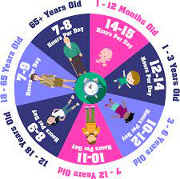
What time do you begin the routine?
You need to give your child a warning that games/TV etc is coming to an end. 5 or 10 mins is usually best.
The routine could take 30 mins to an hour depending if there is a bath/shower and if they need a physical ‘workout’ first. Again this is up to you and how much time you have.
What time you want your child in bed, is a family’s personal choice.
If you work late you might not want them in bed before 7pm or have the time to make tea and bath, so work to what suits.
How much sleep is recommended for each age group.

Slide 6

Release the energy!
Some children have a lot of built up energy and need to release it, especially after being fuelled by tea. If they have been sat watching TV or doing something static; sitting/laying they may not be ready to just go and lie down in bed.
Children with a lot of energy or perhaps ADHD or similar, will need to tire themselves out before attempting to go to bed.
Set up a 10min workout which is going to raise their heart rate.
*Jogging route (around house or garden -when it’s light) with timer -they are used to the daily mile at school!
*Dancing –put on some music and dance your socks off
*Create your own circuits with stations such as; jumping jacks, planks, marching etc.
*Pushing/pulling activities (resistant bands)
*Jumping (trampoline/trampette/reaching a spot) –Good for refocussing energy
*Be inventive you don’t need a big space or equipment

Slide 7
Calm time;
If your child has just done a ‘work out’ or your child has already been burning off their energy all evening, they need some quiet down-time. Away from blue light, not competitive and not over stimulating.
Switching off blue light is really important as blue light promotes alertness and performance, by supressing melatonin, which is what is needed to promote sleepiness. So devices such as tablets, phones even some LED lights need to be turned off- ideally 1 hour before sleep. Daytime blue light is ok but at night time it tricks the brain not to produce the melatonin. New TV’s have a blue light reducing setting or turn the brightness down.
Ideas for quiet down-time in the evening, before getting into the bath or bed:
Jigsaws or similar puzzles
Colouring/ drawing
Sensory play –playdough, sand, bubbles, aqauabeads etc
Rocking/ gentle swinging
Writing (if they enjoy this)
Knitting/sewing/crafting –keep it simple and calm
What they find relaxing and you feel is appropriate

Slide 8

Bath and PJs
Again this is what your routine is. Some children bath every night, some every other, some 2-3 times per week. There are lots of “bedtime” bubble baths available and lavender essences you can add, to create a calming relaxing atmosphere. Between baths you may use the bedtime moisturisers or talcs so that the lavender smell is associated to sleepy time.
A warm bath for 10mins (use a timer if needed) is calming for body and mind.
Once in PJs, make it the rule, that now everyone’s voice-volume is decreased. No shouting from older children, adults or the children.
This is now the last opportunity for a drink of water and toilet. Let them know once in bed that is where they stay. So encourage them to try on the toilet before going into bed.

Slide 9


In to bed
Bed Pillow-talk:
A quiet time to talk about their day or the day ahead. It makes time for all the questions (they may have usually got out of bed) to ask. Often it is the only 1:1 time you get to just sit and chat.
Use this time to stroke their hair, massage their hands or feet –or what they find relaxing.
Story:
Use this time to share a favourite story or to read their reading book. It could be a book about going to sleep or addressing a fear they have at bedtime e.g. the dark, being alone etc.
Make a story up, your child being the main character, could they tell you a story. Make this 1:1 time special, so they look forward to it.

Slide 10

Resources in the room:
Black out blinds or curtain lining – keep the room as dark as possible from outdoor lighting, car lights and in summer -the sun.
Weighted blanket – These can relieve anxiety, stress and insomnia by feeling like the child is getting a “hug” whilst in bed. They distribute weight evenly across the body. You can choose between 2kg - 9kg. It is recommended that it is 10% of the child’s body weight. They vary in price from around £19+. They encourage deep and restful sleep. Useful for all children but recommended for children with ASD and ADHD.
They can come with loops to attach to their own cover.

Slide 11
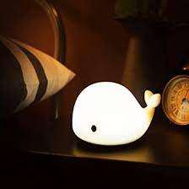
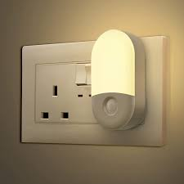
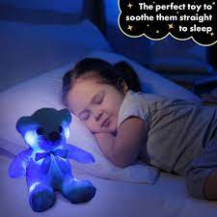
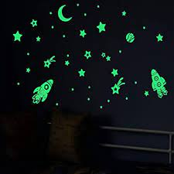
Night light or timer on lamp –
Lots of variety to choose from, the plug in variety, characters, simple lamps, low glow, a glowing teddy etc.
If it helps a child who is afraid of the dark then this is a good thing, just ensure it is not LED blue light or too bright that it is distracting to sleep.
You could leave a landing light on and the door ajar and then switch that light off when you go to bed.
Night light displays with stars and patterns, projectors are not just for babies/toddlers, they suit some children who like that sensory feedback to feel at ease. It could be as simple as glow in the dark star stickers on the ceiling.
Sometimes just knowing they have a torch available next to them, should they need it, eases that anxiety and allows them to sleep.

Slide 12

Music /Sounds –
Some children do not like the silence bedtime brings, as then they can hear the creaks and noises of the house, whether it is the pipes or other people moving around but their imagination makes it become something scary.
You could play soothing sounds, quiet lulling music. But it is finding what they like and find comforting before bedtime comes around. Where some people like the sound of waterfalls or the sea, it personally makes me need the toilet, so would not suit me. Or there are meditation audios to listen to.
YouTube have an array of different audios that can be 10hours long and so even if your child woke during the night they would be comforted back to sleep.
10 Hours Of Sleeping Music For Kids | Unicorn's Dream - YouTube
FALL INTO SLEEP INSTANTLY ★︎ Relaxing Music to Reduce Anxiety and Help You Sleep ★︎ Meditation – YouTube
Hot Air Balloon Ride: A Guided meditation for Kids, Children's Visualization For Sleep & Dreaming - YouTube

Slide 13





Bedtime books:
This can be any story from books to your imagination telling/acting out a story.
Favourite books
School reading books
Therapeutic books
There are books that discuss; what is scary, if they are worried about staying somewhere new, scared of the dark etc.
You can always research books that are read aloud on YouTube before buying to see if it is suitable.

Slide 14

Goodnight, lights out.
Now it is time to say Good night.
You will have already gone through the bedtime plan and your child will know that it is; kiss/hug, goodnight and main or lamp light out now.
Do not get into conversation or delay tactics.
Keep your language simple “Bedtime now” “Goodnight”
If there are initial tears, although hard, still walk out and follow your routine. Go back after a few minutes, if the crying continues, a reassuring kiss on the head “it’s ok, goodnight” again no conversation.
If they get out of bed. No conversation, lead back to the bed, simply “bedtime now” and put back in bed.
Use a calm whispering voice, even if you are feeling agitated.
If you have a visual timetable (next slide) point to the final part – no conversation.
No more drinks. If they say they need the toilet you need to let them go, but no engagement.
Although it may take a few attempts, persevere.

Slide 15
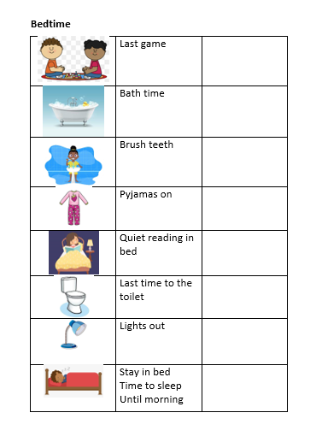
Visual Timetable -
Just like in school some children prefer to see what is happening and what is happening next.
You could make your own visual-timetable and move an arrow to each activity or tick each activity as it is done.
If you would like a laminated copy from school then please just ask along with your family personal routine.

Slide 16
Any questions???
I am aware this was a whistle-stop tour.
There are so many individual issues each child can have. When you have more than one child, when siblings share a bedroom etc.
Now is the time to ask, if it has not yet been covered.

Slide 17
Useful Website links
Children and Sleep | Sleep Foundation
Sleep Advice Service – Cerebra (recommend the Sleep booklet to download)
Dreamscene Star Kids 3kg Weighted Blanket | Dunelm
CBeebies - Andy's Wild Workouts (bbc.co.uk) (energy release)
Beautiful Sleep Music for Kids 💜Nap Music Deep Sleep | Calming & Soothing Bedtime Music – YouTube

