Slide 1


Slide 2


Slide 3
When?
Departure Monday 10th February – all children to take their luggage to the hall. We will leave by 9:30am and arrive at Bewerley by 10:30am
Return Friday 14th February at approximately 2:30pm – you’ll be allowed to take your children straight home.

Slide 4
Who?
All week – Mrs Hannam, Miss Mossop, Miss Harrigan and Mrs Greenstreet
We are in need of 1 parent helper as well.

Slide 5
Medical
Please pass all medication to Mrs Hannam on arrival on Monday 10th
She will have a bag to collect it in. This will then be passed to the children’s activity group leader on arrival.
Medication must be clearly named with clear instructions for use.

Slide 6
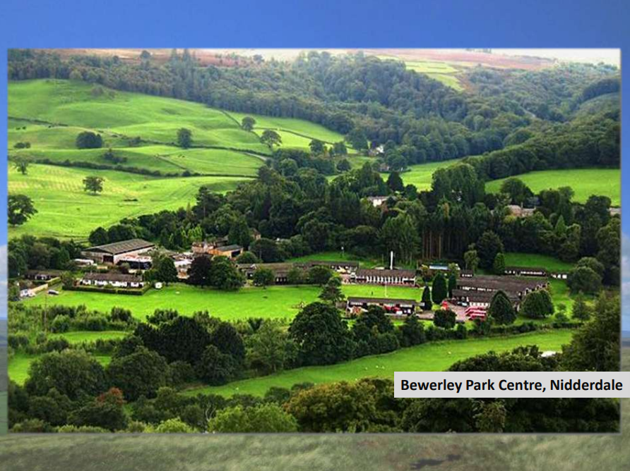

Slide 7
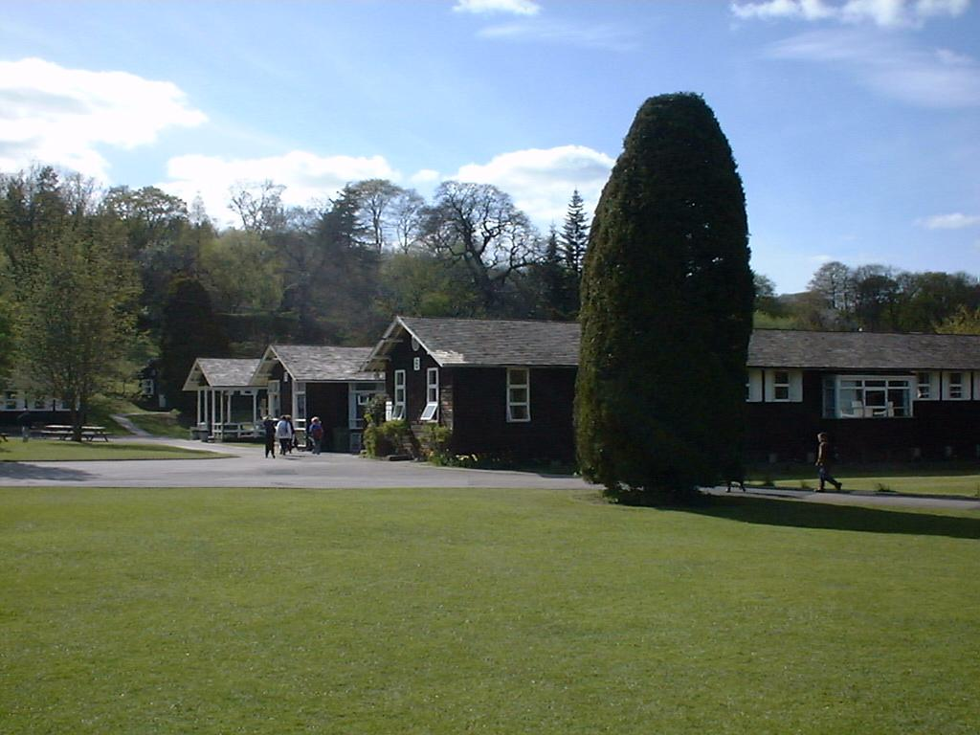
The Centre Buildings

Slide 8
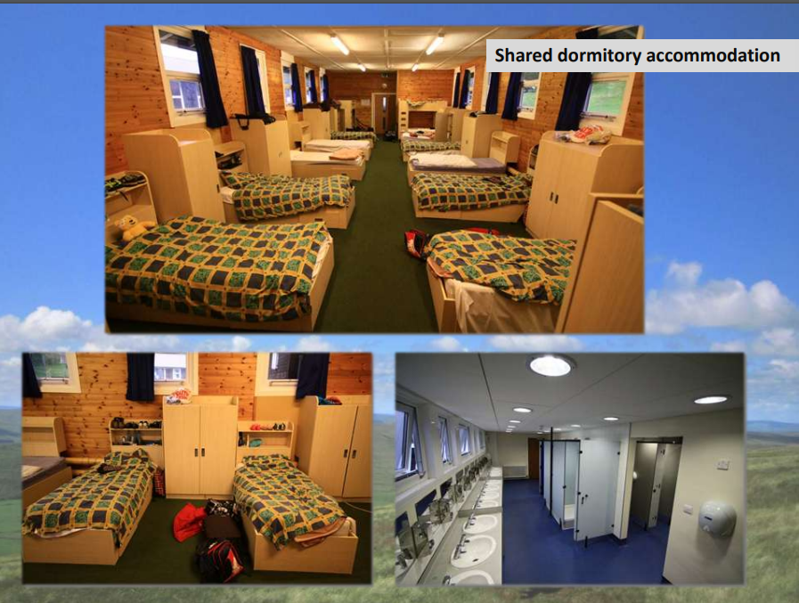

Slide 9
Accommodation
Rooms can vary in size and the amount of beds.
There will be two girls dorms and two boys dorms
At least one member of staff will have their room next door to a dorm.
You are responsible for keeping the room tidy. Your member of staff will give you a mark out of 10 when they come for inspection each morning. There will be a prize for the winning dorm at the end of the week!

Slide 10
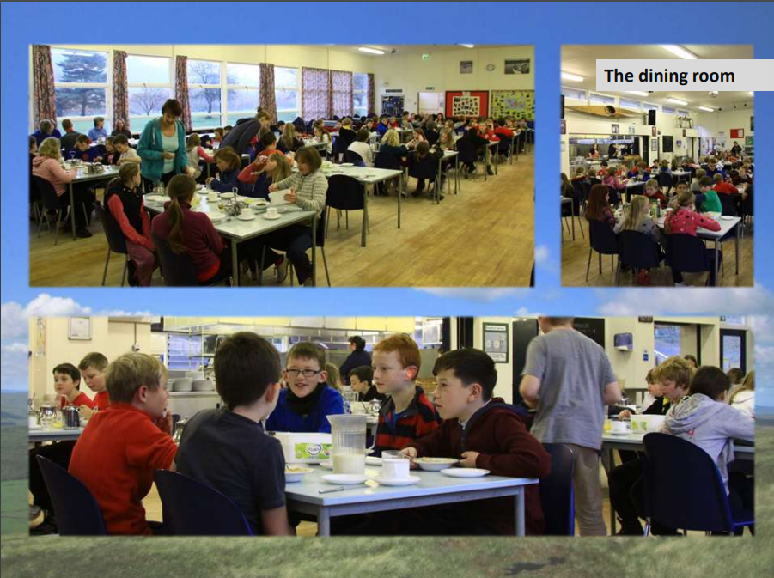

Slide 11
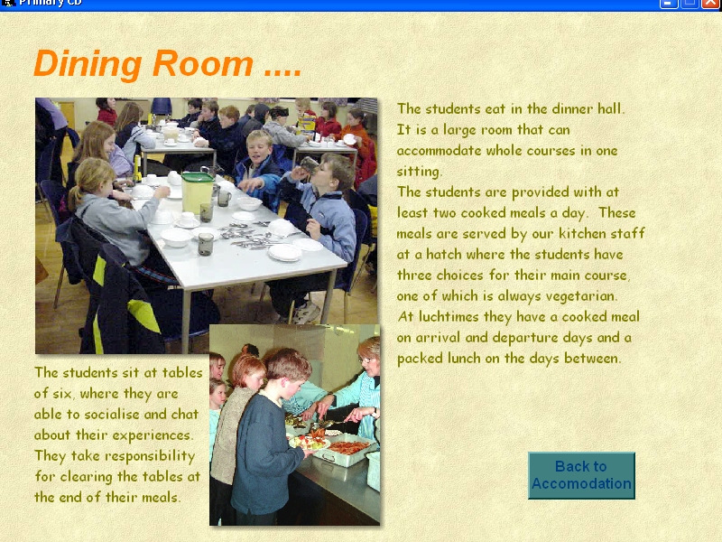
Please let us know about any dietary requirements on the medical form or speak to us separately as necessary.

Slide 12
Outline of day one
Arrive at school at 8:40am and go straight to the hall through the KS2 gate with your luggage.
The bus leaves by 9:30am
Arrive, sort dorms, make beds, unpack, collect kit
Lunch
Split into 4 activity groups for first activity – All groups will do all activities.
Showers / Dinner
Evening activity

Slide 13
Day 2 - Day 4
Breakfast / tidy dorms
Activity 2
Lunch
Activity 3
Shower / chill time
Dinner
Evening activity

Slide 14
Day 5
Breakfast/ strip beds
Final activity
Pack and clear dorms
Lunch
Depart for school 1:30pm
Arrive back at school approx. 2:30pm
Home and sleep!

Slide 15
Activities
Canoeing
High Ropes
Treasure hunt
Orienteering
Brimham Rocks - scrambling and climbing
Gillfield mine
Bushcraft
River walk
Evening activities
nightline
night walk
team challenges
disco

Slide 16
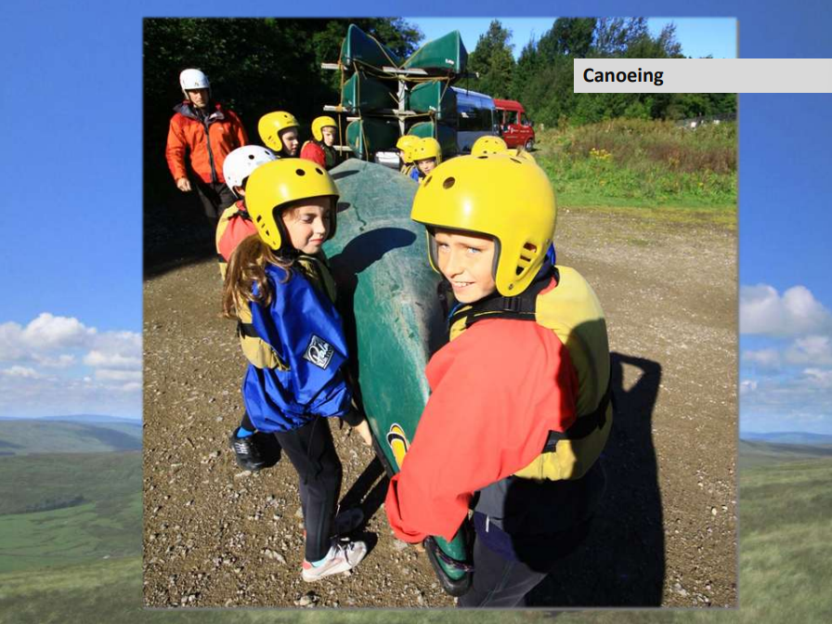

Slide 17
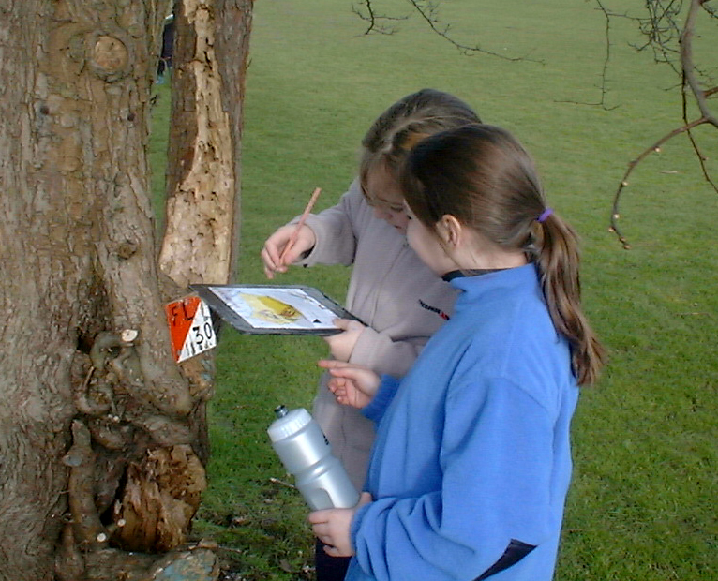
Orienteering on the centre grounds

Slide 18
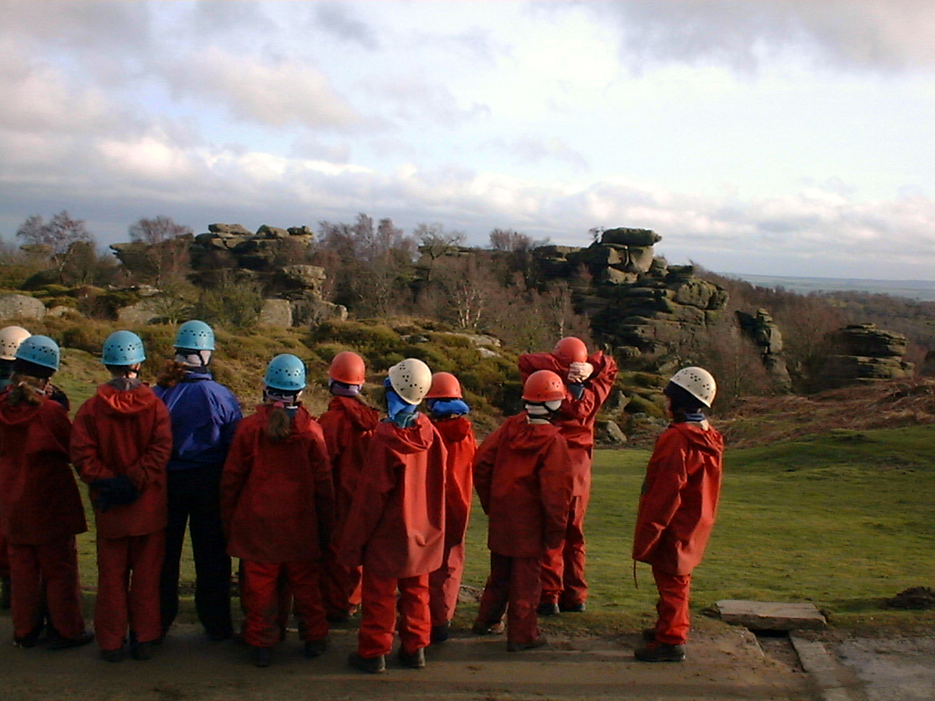
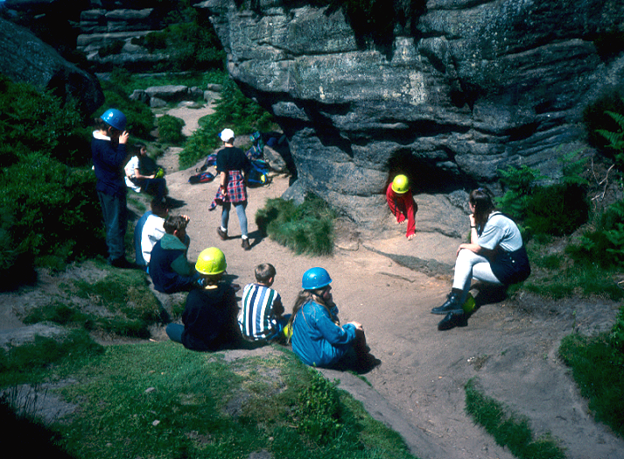
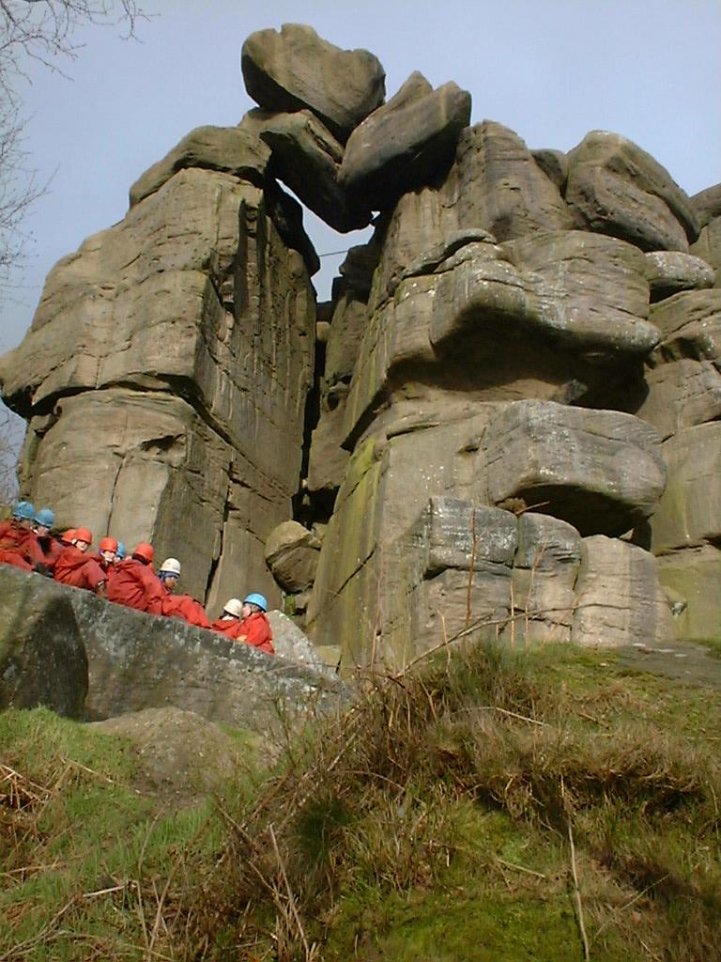
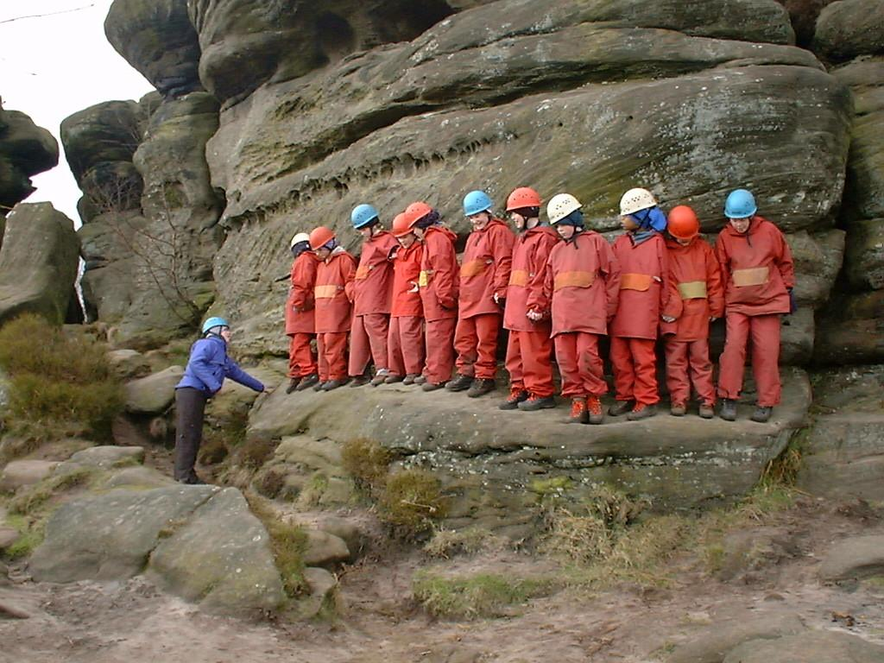
Brimham Rocks

Slide 19
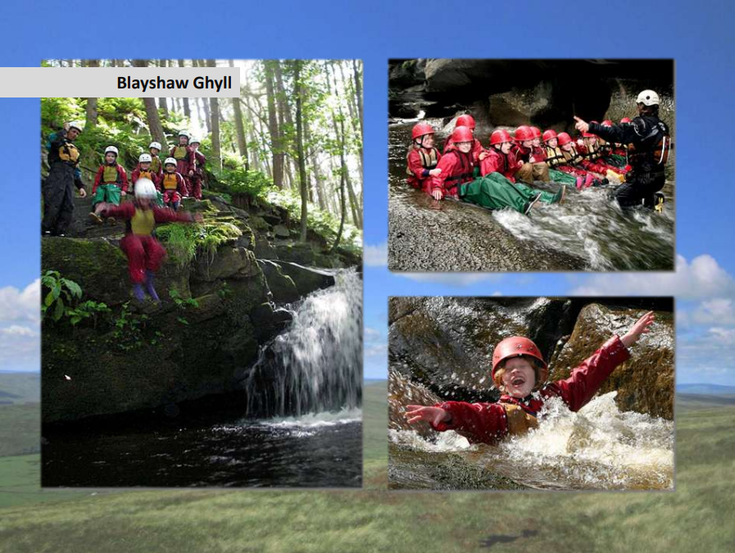

Slide 20
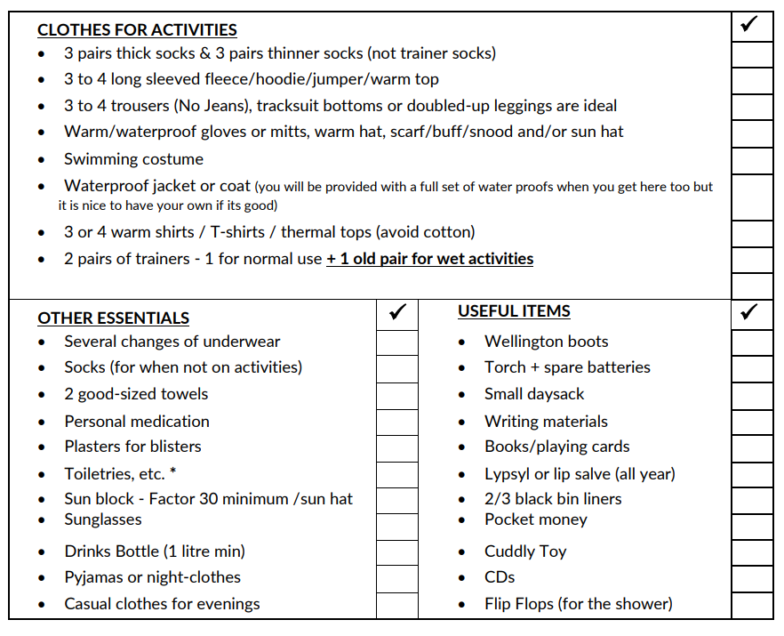
Kit List

Slide 21
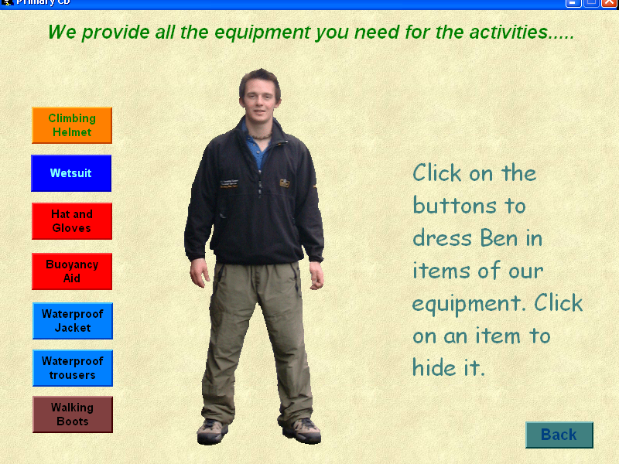

Slide 22
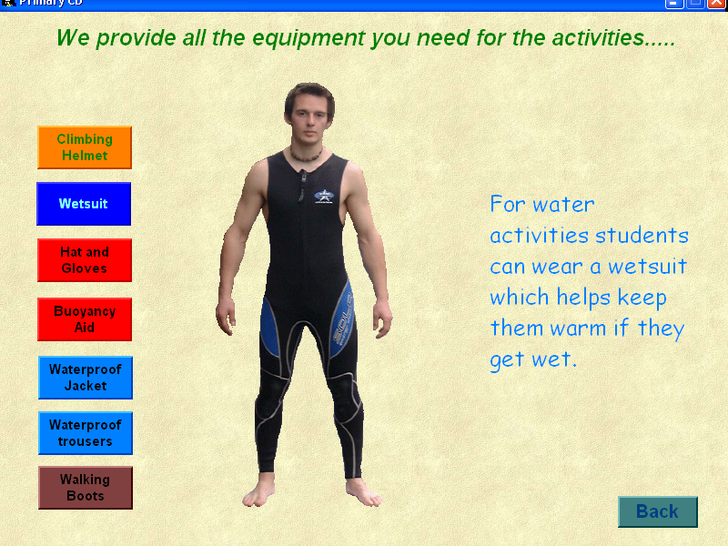

Slide 23
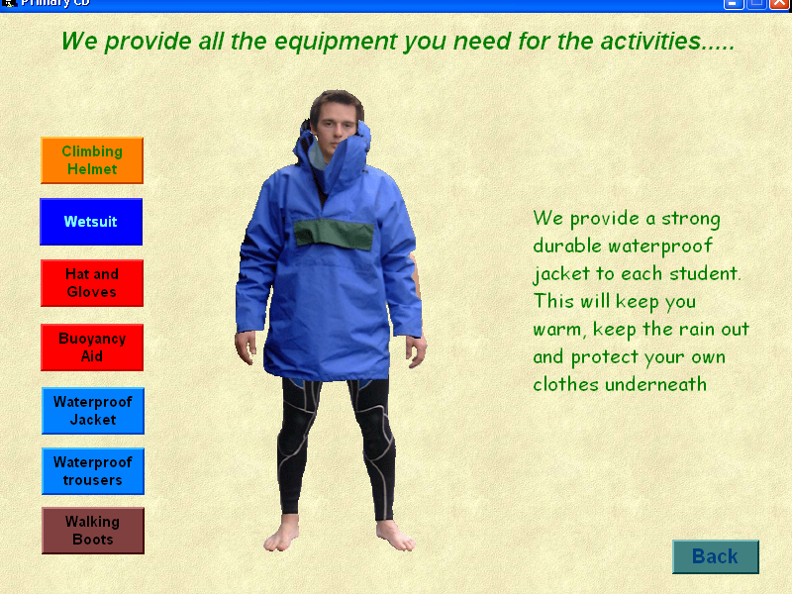

Slide 24
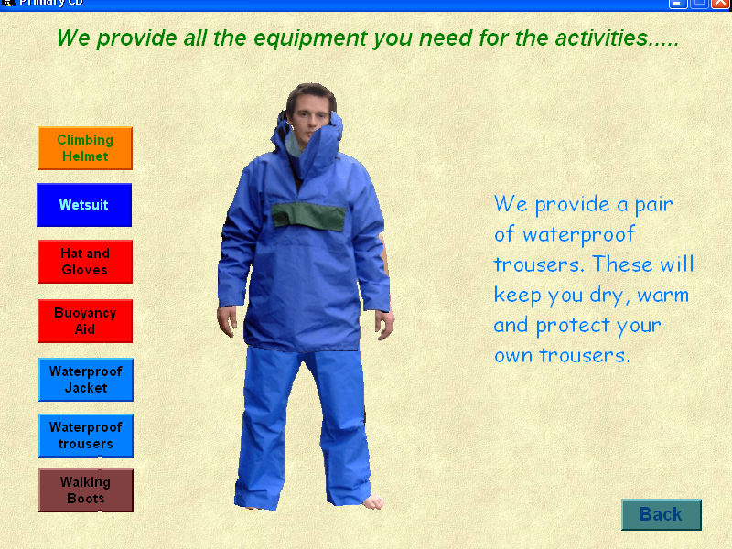

Slide 25
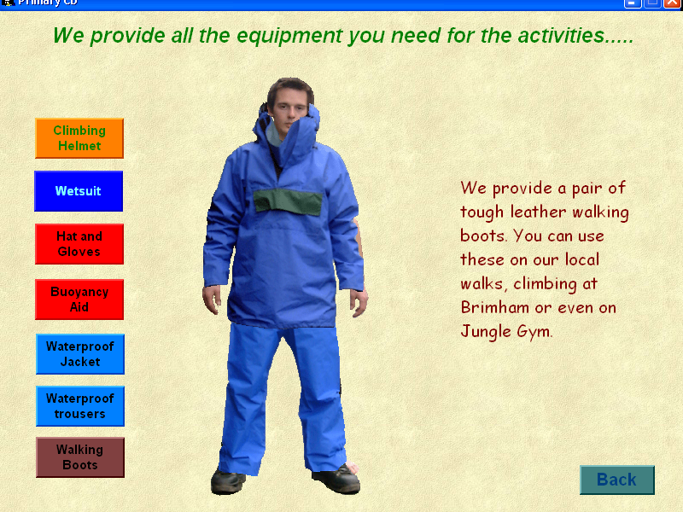

Slide 26
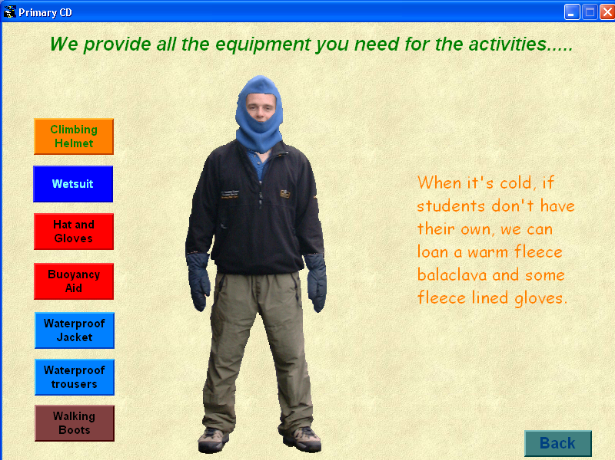
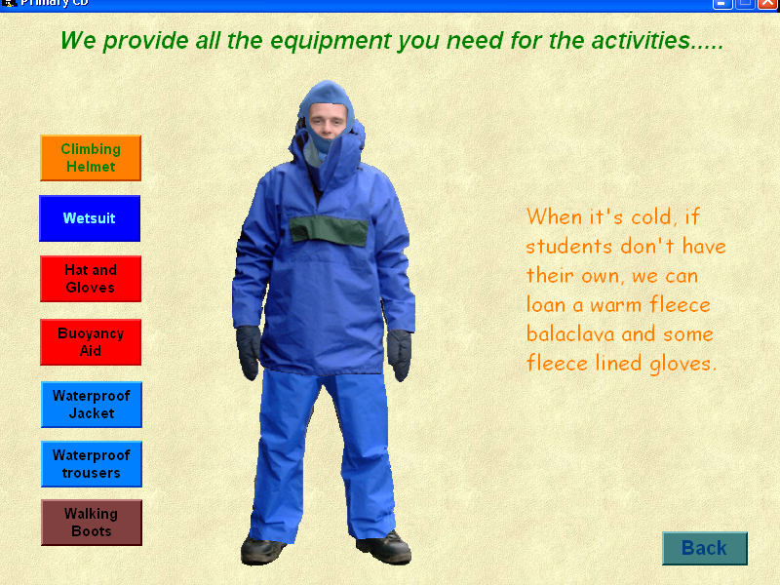

Slide 27
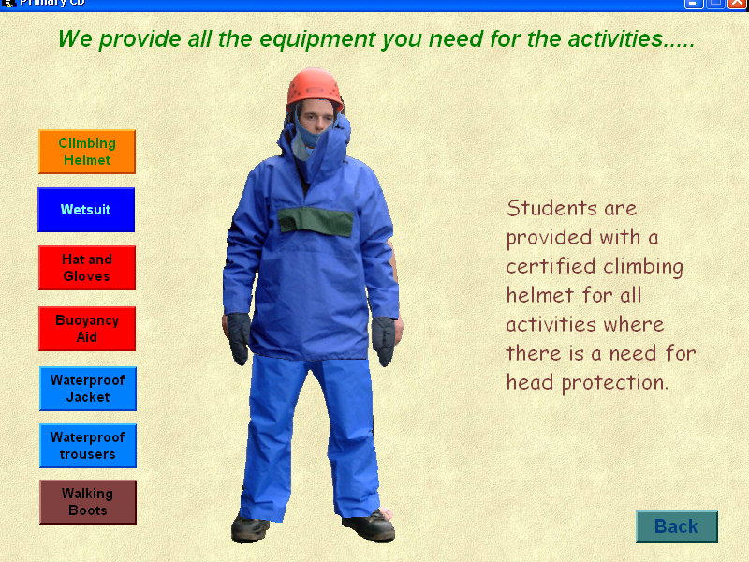

Slide 28
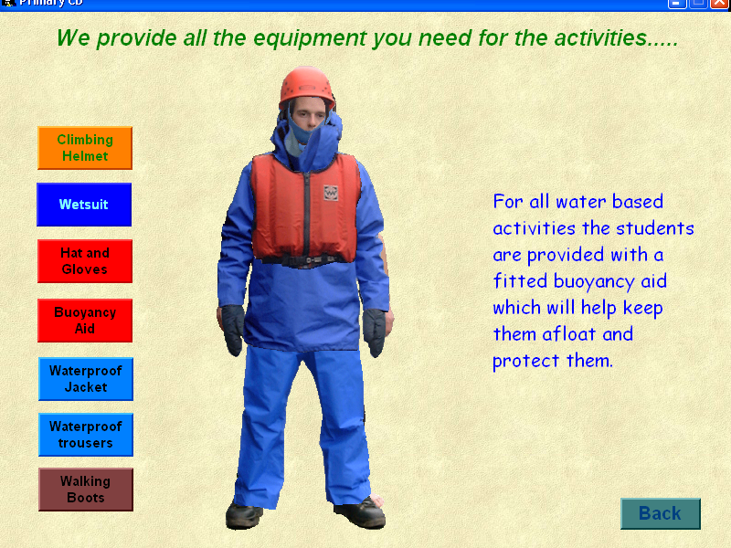

Slide 29
Packing notes
Please ensure all clothing and personal possessions are named.
There is not a safe for valuable and mobile phones and electronic devices such as tablets are not permitted on site; please leave them at home and enjoy nature!
No aerosol deodorants – please bring roll-ons or alternatives.

Slide 30
Packing notes
£10 spending money maximum – preferably in change for the tuck shop. There will be some treats and souvenirs available for children to buy.
Spare plastic bags to keep dirty laundry separate.
Children must help with the packing!
Please be prepared with layers!
Snood, gloves and hat are essential.
Spare clothes are helpful.

Slide 31
Once we’re there
We expect the best behaviour - 3 strike system
It’s important that you are kind and considerate towards your roommates
Talk to an adult if you are unsure about anything

Slide 32
Both the presentation and the kit list can be found in the children’s section on our school website, under residentials.
https://outdoored.co.uk/bewerley-park-outdoor-centre/
Any questions?

