Slide 1








Accreditations

Slide 2
Aims & Activities
Aims:
To develop a love of the outside world and nature
To develop resilience and confidence
To develop collaborative and teamwork skills
To experience time away from home and develop coping mechanisms
To experience challenge

Slide 3
When
Wednesday 14th May to Friday 16th May

Slide 4
Who
Mrs Hargreaves
Miss Galtrey
Mr Fenning
Mrs Parratt
Miss Harragan

Slide 5
Medical
Medication must be in a bag and clearly named with clear instructions for use.
Please pass all medication to Mrs Hargreaves. This will then be passed to the children’s activity group leader.

Slide 6
Outline of day one
Arrive at school at 8:40am and go straight into school through the KS2 gate.
The bus leaves by 9:15am
Arrive, sort dorms, make beds, unpack
Lunch
Activity 1
Showers / tea
Evening activity

Slide 7
Day 2
Breakfast / tidy dorms
Activity 2
Lunch
Activity 3
Shower / chill time
Dinner
Evening activity
Supper

Slide 8
Day 3
Strip beds
Breakfast
Pack bags
Activity 4
Lunch
Return to school- approx 3pm
Notes:
Strip beds before breakfast.

Slide 9
Accommodation
Rooms can vary in size and the amount of beds. Often they are bunk beds.
A member of staff will have their room within the building.
Children are responsible for keeping the room tidy – members of staff will give you a mark out of 10 when they come for inspection.

Slide 10
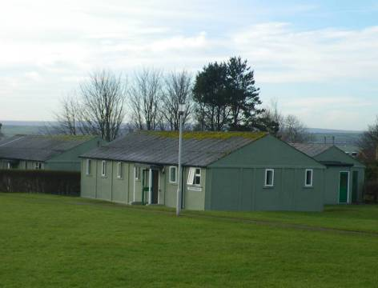

Slide 11
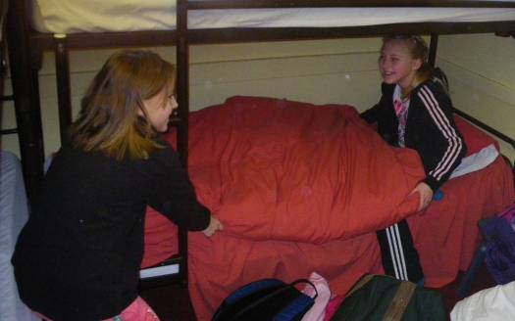
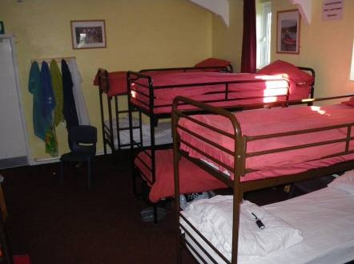
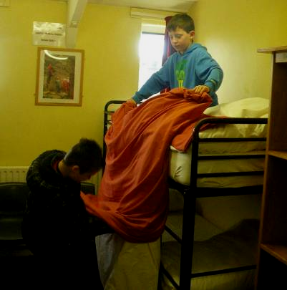
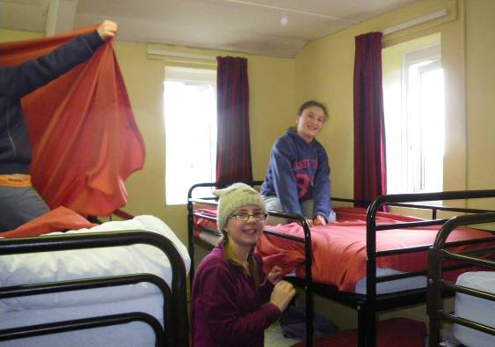

Slide 12
Food
There is a large range of food.
Breakfast – cereals and a cooked breakfast.
Lunch – pre-ordered sandwiches, sausage rolls, crisps, flapjack, chocolate biscuit, fruit
Hot dinners with lots of choice
Supper – hot drink and a snack
Pack-up needed for Wednesday to be eaten at East Barnby.

Slide 13

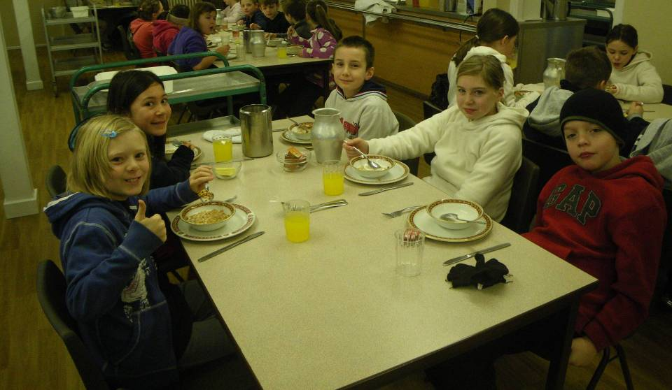

Slide 14
Activities
Hike up Roseberry Topping
Seashore Explore
Orienteering
Bodyboarding

Slide 15

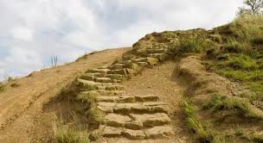


Slide 16
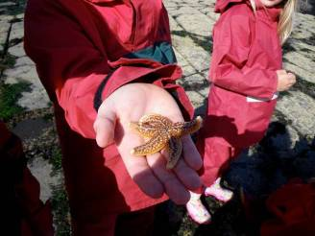
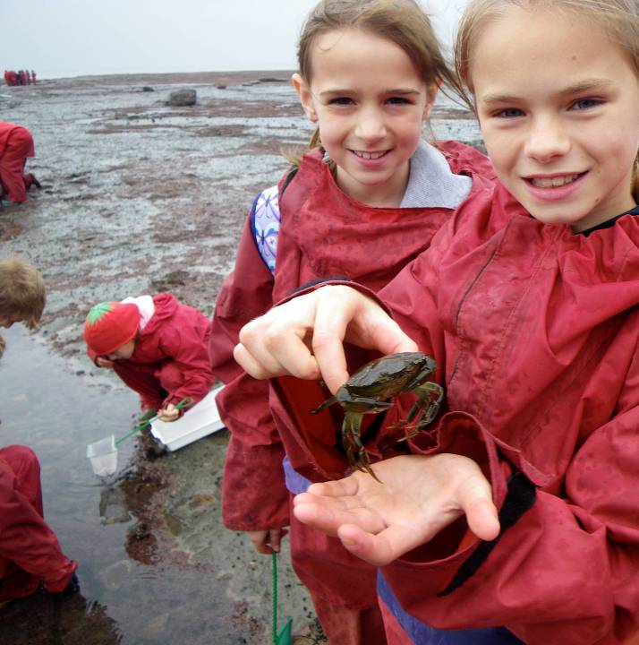
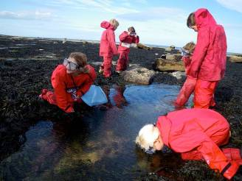
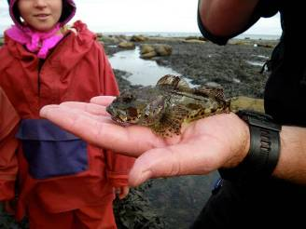

Slide 17
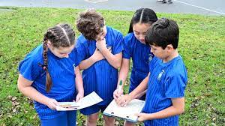
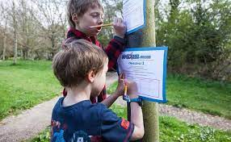
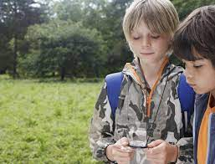

Slide 18
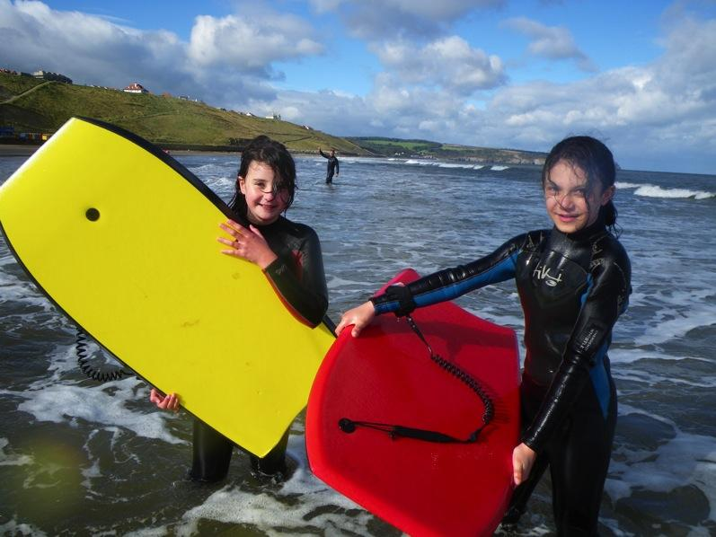
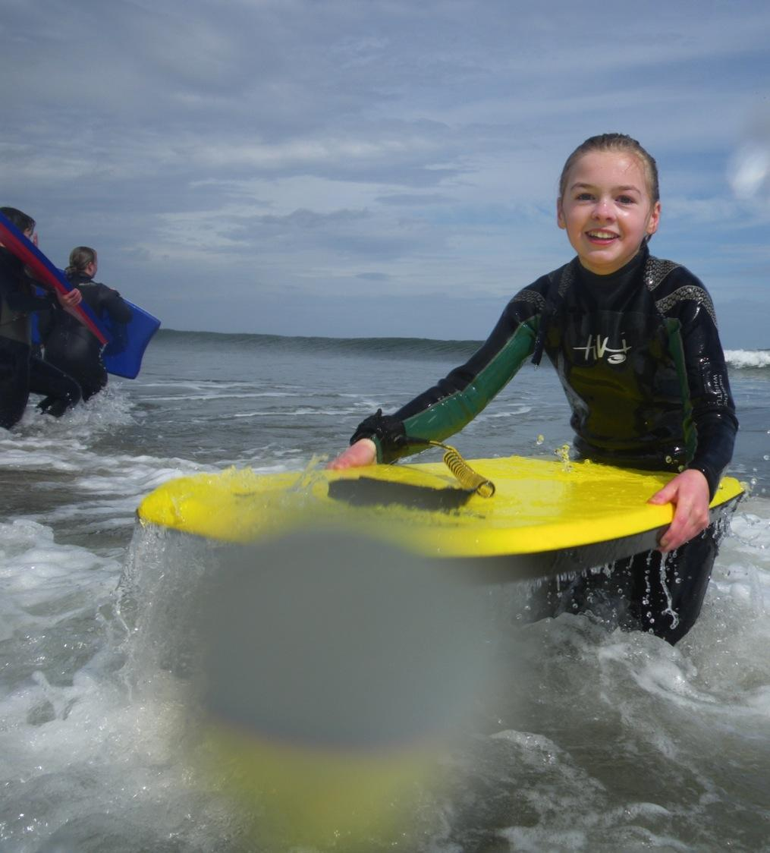
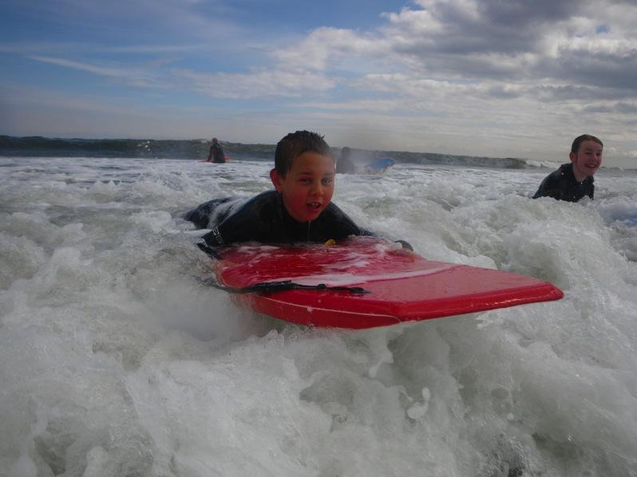

Slide 19
Before you go!
Children must help to pack their bags
Spare plastic bags to keep dirty washing separate
Name all items you are sending to avoid losing them
East Barnby provide specialist equipment such as walking boots, wetsuits for all children

Slide 20
Before you go!
Please send sensible clothing:
Jeans are only for the evening, not for activities.
Long sleeve tops are better as they protect arms.
Extra clothes are useful
Swimwear to put on beneath wetsuits
Trainers with a good grip

Slide 21
Before you go!
Be prepared for all weathers.
Don’t forget a towel
Pyjamas, slippers, reading book and teddy.
No technology – tablets etc… We are going to escape modern life and appreciate nature.

Slide 22
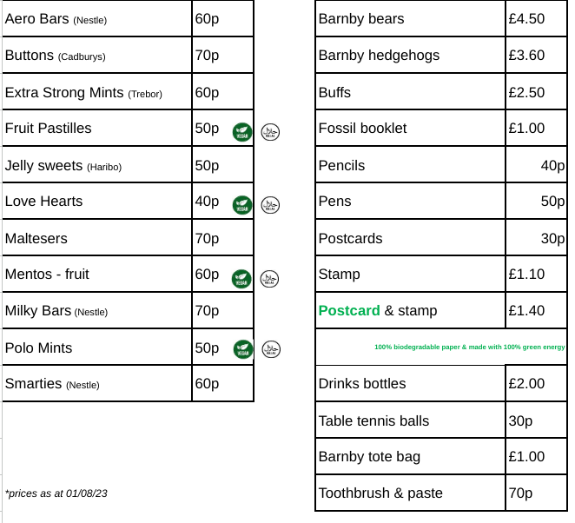
The shop
Children can bring up to £7 in change to spend in the East Barnby shop.
Please put it in an envelope with your child’s name on it.

Slide 23
Once we’re there!
We expect the best behaviour.
It’s important that you are kind and considerate towards your roommates.
Talk to an adult if you are unsure about anything.

Slide 24
Any questions?

